Slide 1
Project Status Report
Name: Palak Jain
Institute: NLIU, Bhopal
Mentor Name: Shri Vinayak Mohan Prasad
Institute: Senior Adviser, WHO
Notes:
Graphics, tables, and graphs
Keep it simple: If possible, use consistent, non-distracting styles and colors.
Label all graphs and tables.

Slide 2
The relevance and effectiveness of and community support to Cigarettes and Other Tobacco Products (prohibition of advertisement and regulation of trade and commerce, production, supply and distribution) Act, 2003 (COTPA, 2003)

Slide 3
Contents
Project Overview
  What is the project about?
  Goals and Objectives
  Scope of the project
Your approach towards the project
Field visits and Mentor Discussion
Key Findings
Results and Discussions
Recommendations, their scope and Flow chart (Strategy) for Implementation
Suggestions for future work

Slide 4
Project Overview
Understanding the relevance and effectiveness of and community support to COTPA, 2003.
Project deals with the following provisions of COTPA, 2003
Prohibits smoking in a public place. ( section 4)
Prohibits sale of tobacco products to a minor and in an area within 100 yards of any educational institution. (section 6)
Prohibition on production, supply and distribution of tobacco products without specified warning including pictorial warning as may be prescribed. (section 7)
Manner in which the specified warning is to be made. Depiction of a pictorial health warning (section 8)
Notes:
Project Overview
What is the project about?
Define the goal of this project
Define the scope of this project

Slide 5

Project Overview
Girls in Kerala do not wish to marry a tobacco user
A study conducted with unmarried females in the Kannur district of Kerala to determine their attitude towards tobacco smokers and marrying a smoker revealed that 99.3% of the females were unwilling to marry a person with the habit of tobacco use.
awareness on health effects caused due to tobacco smoking.

Slide 6
Project Overview
Tobacco kills nearly 6 million people each year across the globe.
About 6 lakh people who die are second-hand smokers.
India considering the gravity of tobacco menace ratified WHO FCTC in 2005 and parallel to this adopted anti-tobacco law in 2004 (COTPA, 2003)
The anti-tobacco legislation in India started with the promulgation of Cigarettes Act.
Evolution of COTPA- From Bill to Act.
Problems persisting are : Weak implementation - partly due to specific weaknesses in COTPA provisions, many of them because of lobbying and litigation by the tobacco industry, and part, due to laxity in enforcement.

Slide 7
Goals and Objectives
The key objectives for developing this report are:
Understanding and analyzing the way Tobacco control law has evolved in India in the parliament.
Monitoring the working gap between law and its enforcement.
Focusing on the evolution and implementation of sections 4, 6 and 7 through literature review and undertaking an observational study and a survey to gauge enforcement level of the same.
Studying how the judicial action has helped improve or stall the implementation of the above-mentioned sections.
Analyzing issues that try to curb the law, particularly the tobacco industry interference. Also, coming up with suggestions and recommendations to strengthen the law.

Slide 8
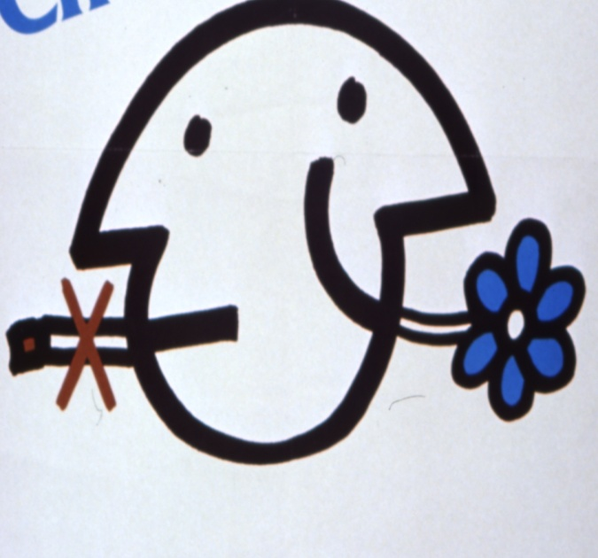
Goals and Objectives
Goal- To disseminate the study among policymakers and stakeholders in order to help them strengthen the existing tobacco control law and assure strict observance and compliance with the same

Slide 9
Scope of the project
The project analyzes COTPA, 2003 provisions and particularly sections 4, 6 and 7. Also, it analyzes WHO FCTC, particularly articles 8, 16 and 11. A comparison is then done to see whether COTPA satisfies the treaty’s given minimum obligations or not.
Evolution of the tobacco control law in India is tracked through, specially by reading the discussion of the parliamentary standing committee on tobacco draft bill, various government notifications after the enactment of COTPA and significant case rulings related to it.
Extensive literature review is to be done for understanding the problems and gaps in successful implementation of COTPA and the reasons for the same. Field study is needed to know the actual compliance and awareness level of the specified COTPA provisions. Recommendations are to be sought then to overcome these problems

Slide 10
Your Approach Towards the Project
Developed a strong theoretical understanding of my project by reading lots of reports, case rulings, legislations, research papers (published and unpublished) and other primary and secondary sources. Internet and web based research was used most.
Undertook a survey interview in order to gauge the pattern of tobacco consumption, community awareness/support/opposition to particular sections of COTPA and effectiveness of them in tobacco cessation. The respondents targeted were from the age 16-30, to particularly highlight the youth awareness and compliance levels. Also carried an observational study to gain a first hand view of the situation when it comes to tobacco control.
Talking to officials who work in various departments and organizations dedicated to tobacco control efforts.
Notes:
In this slide, mention: after understanding the problem how you decided to approach it?

Slide 11
Field visits, Meetings and Interviews
Sr. No. | Date and time | Person or Organization | Place | Aim | Findings
1. | 24th May | Shri Vinayak Mohan Prasad | Via email | To decide the focus of research | Importance of such legislation & challenges, Smoke free areas, graphic health warnings, ban near educational institutions, tobacco industry interference and cases related thereto.
2. | 11th June | Shri Vinayak Mohan Prasad | Via email | To plan visits to officials | Evolution of COTPA in parliament, judicial intervention and got me in touch with Dr. Jagdish Kaur

Slide 12
3. | 12th June | Dr. Jagdish Kaur (MoHFW) | Telephonic conversation | Government efforts for tobacco control. | Told me about the current government initiatives for tobacco control
4. | 29th June | Shri Vinayak Mohan Prasad | Via email | Feedback of the mid term report | Asked to incorporate Problems with ban on gutka, Smoke free regulations, 2008. Graphic health warnings at points of sale.
5. | 9th July | Mr. Amit Yadav (PHFI) | Telephonic conversation | Legal advocate’s view | Evolution of anti-tobacco law and legal advocacy for promotion of tobacco control

Slide 13
Key Findings

Slide 14
Key Findings
Evolution of tobacco control legislation
Cigarette Act, 1975.
Executive orders and Court orders.
Other Acts and amendments
COTPA , 2003

Slide 15
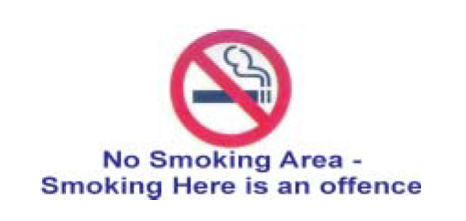
Key Findings
SECTION 4 – GoI in October, 2008 notified the rules – adding more authorized officers to enforce the law and stringent specifications for making a smoke area or space.
Knowing that smoking is banned in public places can itself create awareness depending on the coverage extended by media and the implementing agencies reaching out to the public.
there is no safe level of exposure to tobacco smoke and only 100% smoke-free environments can protect the health of people.

Slide 16
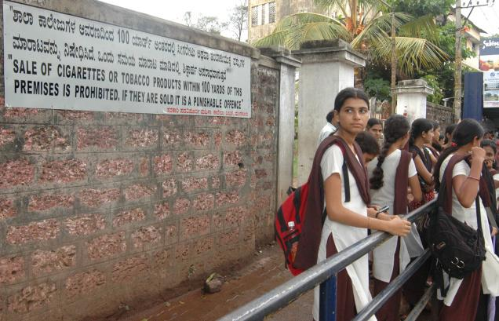
Key Findings
Section 6 (b)- Actual implementation was warranted by the Bombay High Court in 2009, in response to a petition filed by a Civil Society organization seeking enforcement of this important provision of the law.
New notification that came in August 2011 mandates health warning boards at points of sale with 50% of the board depicting pictorial health warning.
Implementation tardy.

Slide 17
Key Findings

Slide 18
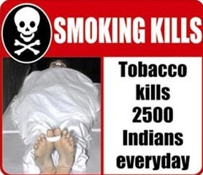
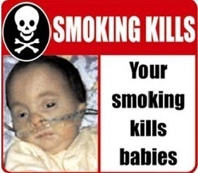
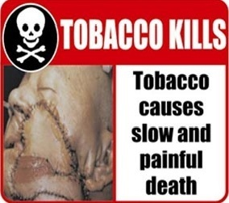
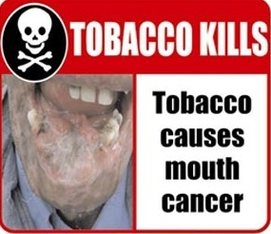
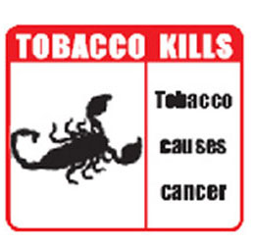
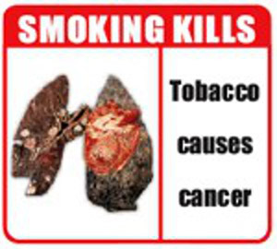
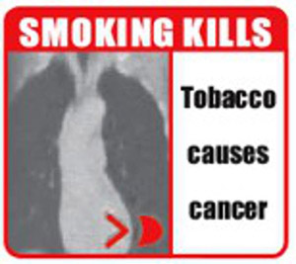
Key Findings
Section 7 – Pictorial Health Warnings
To be implemented from feb, 2007 extended to June 2007
Warnings further watered down. Same warnings were to be implemented from September 2007 (without skull and bones). Till then no warnings implemented.
After seeking many extensions from the court and making the warnings further mild, government announced 31st May, 2009 as the date of implementation.

Slide 19
Key Findings
Shimla High Court case and the Health for milllions Case.
Amendment of the rotation period
New warnings since May 27th 2011relatively strong for smokeless forms. Do not conform to WHO FCTC standards; implementation tardy.

Slide 20
Key Findings
From field study-
Reinstate the findings from literature review, more grave rather.
Hukka parlours are an impediment to the smoke free environments.
Ban near educational institutions has not been effective in actual scenario.
Pictorial health warnings because of their very mild nature create no emotional impact on the users and thus they should be field tested.

Slide 21
Results and Discussions
Although both the government and non-government sectors are putting efforts in order to achieve a tobacco free society. Tobacco menace still continues because of:
Weaknesses in COTPA provisions
Uncertain political will
Tobacco industry interference
Unawareness about the Act or dangers of tobacco not only among citizens but also among policy enforcers and media personnel.
Laxity in enforcement
Judicial intervention has however, helped very much in the progress as well as implementation of COTPA provisions. And there is much more scope to it. (Ex- Bombay High Court in implementing section 6(b) )

Slide 22
Results and Discussions
Various provisions have seen a regression rather than a progression either in their draft stage or when it comes to notification or implementation of particular provisions.
(For example- During the discussion on the draft bill hospitality sector asked for smoking zones in hotel with 50 rooms or more and restaurants with 50 seats or more, however the committee not just agreed to their demands but also reduced the fifty to a thirty.)

Slide 23
Gap Analysis
An independent monitoring of implementation of COTPA in 21 States, where NTCP is under implementation revealed
only 52% states have mechanism for monitoring provisions and reporting violations.
15 states have established challaning mechanism for enforcement of smoke-free rules, out of which only 11 states collected fines.
ban on sale of tobacco products to minors and ban within 100 yards also remains largely ineffective.
only 55% of the staff positions could be filled at the state/district level.

Slide 24
Gap Analysis
Only 4 states had collected fines for violating provisions under Section 7 (pictorial health warnings).
Sixteen states have started tobacco control activities in schools. Almost all states barring West Bengal and Jharkhand conducted trainings of various stakeholders under the programme.
Thus, the major gap lies in the matters of implementation and awareness of the significance of the act

Slide 25
Recommendations, Scope and Strategy
Multi-pronged approach using multiple sectors required.
1. Anti-tobacco mass media campaigns should be made a priority.
Scope and strategy: Budget allocated should be 36-40 crores a year. Ministry of health and family welfare under the flagship of NTCP.
2. Civil societies should focus on strong media advocacy, public interest litigations and moving into consumer courts for compensation of victims.
3. Plain packaging should be introduced to create greater impact of pictorial health warnings.
Scope and strategy: Cost-efficient way. Governemnt to select/design the warning and ask the companies use plain packaging with those warnings.

Slide 26
Recommendations, Scope and Strategy
4. Comprehensive prevention programmes in schools and communities.
Scope and strategy: Ministry of Education, NCERT and educational boards such as CBSE and respective state boards should work with Ministry of Health and Family Welfare and concerned state health departments. About Rs 10,000 per school per annum (subject to strength and programme method) should be allocated for this.
5. Health professionals should be trained with regards to tobacco cessation of the patients. A clear guideline should be sent to them in this regard.
6. Sale of cigarettes (or tobacco products) individually or in small packets should be prohibited. All tobacco products should be labelled “not for sale to minors”. Health warnings on single cigarettes either in written form or as a symbol such as skull and crossbones or any other suitable depiction.

Slide 27
7. Inter-ministerial coordination
Scope and strategy: Constitution of an anti-tobacco cell in other ministries. It would require staff personnel having the required qualifications and their training primarily. 30-40 lakhs per year can be allocated initially for the constitution.
8. Review of taxation policy.
Scope and strategy: Ministry of Finance to be asked to come up with uniform structure of tax on cigarettes, bidi and gutka.
9. 100% smoke free environments should be made a requirement.
Scope and strategy: notification with this respect and strong implementation mechanism
10.The size of warnings should occupy at least 50% of the principal display area on both the sides of the pack.

Slide 28
Recommendations, Scope and Strategy
11. Different regulatory bodies should be made for monitoring the implementation of different provisions of COTPA under state/district tobacco control cells.
Scope and strategy: dedicated and trained staff personnel. A budgetary allocation of 5-8 lakhs for every regulatory body will be sufficient.
11. Toll-free number for reporting violations needs more publicity among masses. Also, the punishment for sections 4 and 6 is mere Rs. 200 which cannot act as a deterrent and thus should be increased.
12. Tobacco cessation centre in every district and the facilities provided should be subsidized by the government.
Scope and strategy: To spend minimum resources, existing hospitals and health care centres should be asked to start tobacco cessation facilities.
13. National Regulatory Authority monitor and regulate tobacco industry activities by asking them to submit reports on composition of their products or any studies undertaken by them and so on.

Slide 29
Suggestions for future work
Analysis of judicial decisions on COTPA- was the decision "people" or "public health centric" or did it focus more on provisions of the law. Are the judges literally interpreting the law or taking a wide angle? Also, did economics supersede health?
Testimony of lawyers, judges, law makers, executive etc. On what they thought about COTPA provisions.
A much larger survey in order to understand the awareness and enforcement level of COTPA and what reforms can be made accordingly.
An in-depth study of the unorganized tobacco industry sector of India.

