Slide 1
A Study on Exploitation of Surrogate Mothers in India
Parents construct the child biologically, While the Child constructs the Parents socially- Aristotle
Presenter Name: Upmanyu Bhaumik
Presentation Date: 13th July,2013
Mentor: Dr. Jagdish Kaur
Chief Medical Officer; Ministry of Health and Family Welfare
Co-Mentor: Shri Sachin Bansal
Founder President ; Rakshak Foundation
Notes:
Graphics, tables, and graphs
Keep it simple: If possible, use consistent, non-distracting styles and colors.
Label all graphs and tables.

Slide 2
The Commodifiaction of a Baby!

Slide 4
The Baby Johnson Case

Slide 5
Contents
Project Overview
Introduction
Goals and Objectives
Scope of the project
Research Methodology for the project
Field visits and Mentor Discussion
Key Findings
Results and Discussions
Recommendations, their scope and Strategy for Implementation
Time Line
Looking Ahead
Appendix
References

Slide 6
Project Overview
Surrogacy: Surrogacy involves the act of one woman carrying a child for another.
Surrogate Mother: The surrogate is pregnant with her own biological child, but this child was conceived with the intention of relinquishing the child to be raised by others.
Types of Surrogacy: (a) Traditional Surrogacy (b)Gestational Surrogacy
Traditional Surrogacy: Traditional surrogacy, a surrogate is artificially inseminated with the fathers sperm. No fertility drugs are required for this type of surrogacy and there is a high success rate for surrogates with proven fertility.
Gestational Surrogacy: Gestational surrogacy involves fertilizing the mothers egg with fathers sperm in her own womb. The newly fertilized egg is then removed from the mothers womb and implanted in the surrogate in a separate medical procedure.
Notes:
Outlines context, background and purposehhh of the project.
Define the scope of this project

Slide 7
Goals
To know about the new guidelines that have been given by the Ministry of Home Affairs.
To Know about the existing laws all over the world.
To understand how a surrogacy contract is drafted and if there aren’t any laws present in India how these Contracts are drafted and whom do they favor the intended parents or the Surrogate?
To know about the Different laws around the Globe
To know about the living condition of the Surrogates.
Notes:
Define the goals and objectives of this project. What is it that we are trying to achieve out of this project?

Slide 8
Objectives
The Main Objective of this Project is to lessen the Risk of Contractual Disputes and make the Right to Parentage a safe and secure one; So that the Intended parents and the Surrogate both are benefited.

Slide 9
Scope of the project
There is extreme lack of awareness regarding surrogacy in India. Surrogate mothers do not know their legal rights and hence, get exploited. This project aims at bringing out the problems of this troubled section and to attract the attention of people towards enhancing the lives of surrogate mothers.
Notes:
Mention the scope, boundaries and limits of your project.

Slide 10
Feminist responses to surrogacy
Radical feminists critical of surrogacy
Dehumanisation of women’s reproductive labour
Middle-class couples buying services of working-class women
Liberal feminists more supportive
Surrogacy transgresses gendered borders
‘Masculine’ world of commerce enters ‘feminine’ world of emotion and care work

Slide 11
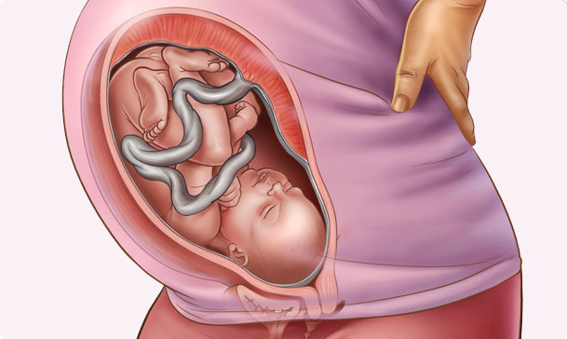
Perspectives from Surrogate Mothers(Met at Upkar Foundation)
Working-class women have very little cultural capital, status, recognition
Caring and care work makes them ‘respectable’
Surrogacy can be seen as a gift of ‘care’
Accrues value to the giver
Achievement

Slide 12
Activities of Upkaar:
Provide information about surrogacy
Educate them properly
Look after before, during &after pregnancy
Suggestion proper food during pregnancy
Take care for their children
Provide mental as well physical support

Slide 13
Activities towards the Intended Parents:
Complete information about surrogacy
Law of surrogacy
Process of surrogacy
Different centre of surrogacy
Meet the Surrogate mother
Exchange information between them

Slide 14
Story of Surrogates:
Smt. Anupama Devi
Smt. Rekha Bajiya

Slide 15
Surrogacy
Exploitation
Slavery
Medical Risk

Slide 16
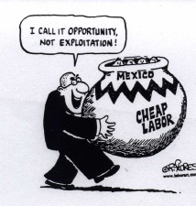
Slavery
Surrogacy is like slavery in the absence of reciprocity, in the fact that one person becomes what Aristotle called an ‘animated tool’ of another, serving simply as a means to another’s end.
Exploitation
When one party takes advantage of another’s economic need to secure something for considerably less than its value.
What is the price of a baby?
In paid surrogacy, something ‘priceless’ is received in exchange for a modest amount of money

Slide 17
Field visits and Mentor Discussion
Sr. No. | Date and time | Person or Organization | Place | Aim | Findings
1. | 21st May,2013 | Advocate Anurag Chawla | Delhi High Court | To Understand the Law | No legislation in India only guidelines and Bills
2. | 21st May, 2013 | New Life Infertility Clinic | Lajapat Nagar, New Delhi | To get exposed to the Living condition of the Surrogates | No Proper Medication and the surrogates are badly tutored.
3. | 29th May, 2013 | Advocate Anurag Chawla | Delhi High Court | To Understand the MHA Guidelines | A Copy Of Guidelines
4. | 7th June,2013 | Hon’ble Justice S.N. Dhingra | Competition Commission of India | To draft a questionnaire
Notes:
Mention all the visits, meetings and interviews along with the key findings, you have done so far, in their respective rows.

Slide 18
Sr. No. | Date and time | Person or Organization | Place | Aim
5. | 13th June,2013 | Ms. Vandana Garg | Parliament House | To get hold the MHA Guidelines
6. | 13th June, 2013 | Mr. P.P.K. Ramacharyulu | Parliament House | To Understand the procedure for passing a Law Commission Report
7. | 2nd July, 2013 | Upkar Foundation | Green Park | To Understand the functioning of the foundation on how they function and how do they work for the benefit of the Surrogates.

Slide 19
Key Findings
The Knowledge about Different Countries
The Knowledge about surrogacy practice in Islamic Country
The Knowledge about why Infertility rises
Found out about the living Condition of the Surrogates
Exposed to the Contracts the Surrogates enter.
The Ministry of Home Affairs guidelines regarding ban of Surrogacy for LGBT
The Indian Industry of Surrogacy in Gujarat
The Reason why women enter in to surrogacy or Paid Pregnancy!
Notes:
In this section report some facts and key findings made by you either by the analysis of the data collected by you or thorough field visits or literature survey

Slide 20
Recommendations:
A Para-financial Surrogacy Model that Includes Limited Relationship Rights for the Surrogate Mother
Allowing an appropriate separation process during the crucial period following the birth
To ensure prevention of the surrogate mother’s exposure to tissue that was not properly tested for viruses such as HIV and Hepatitis B, a procedure similar to that used by the Ministry of Health for IVF sperm donation should be adopted.
Exempt the surrogate mother from pleas and prosecution by the intended parents regarding the health condition of the newborn or regarding any kind of harm that was caused during the pregnancy
Notes:
In this section, mention the recommendations and if implemented what would be the scope of improvement and what strategy you have in mind for implementing these recommendations.

Slide 21
Recommendation:
This project proposes a Model which will be regulating from the grass root level and can control the entire administration and will control all the issues, like what will be the age of the Surrogate to start Surrogacy and the age where she will be debarred from doing so and the maximum number of Kids she can deliver. The Model will also propose to keep a check on the clinics. The model will talk about if exploitation is done how that can be resolved and how the industry can be made more easy to access.

Slide 22
Implementation
The Ministry
The Government
The Infertility Clinics
When These three bodies will work together the Model will be of some help.

Slide 23
Following of Rules and Guidelines
Supervision and strong checks
Smooth Functioning of the System

Slide 24
Setting up a body by the Government
Enact a Legislation
Start Implementing things from the ground level

Slide 25
Surrogacy
Happiness
Satisfaction
Love
Care
Surrogacy
Explotation
Legal Hazard
Slavery
Emotional Torture
NOT

Slide 26
To keep the entire process transparent to the Public
To make the Registration procedure open to all over India with the help of the State Govenments
Formation of the Administrating Body

Slide 27
Timeline: 8 Weeks
Understand the Laws of Different Country and checked out which country Surrogacy is permitted or prohibited.
Preparation of the petition and the study the South African Law of Surrogacy.
Detailed Case Study of Baby M Case
Study of Different reports stating the present scenario of t Paid Pregnancy in India
Notes:
Include a timeline for the project, clearly marking milestones and highlight where the project is now.

Slide 28
Timeline 8 Weeks Contd…
Met various medical person and Visit the All India Institute of Medical Sciences (AIIMS) and also visit National Commission for Women (NCW) for some detailed study on the Rehabilitation procedure of the exploited Surrogates.
Studied the different country perspective of Surrogacy as in Commercial and Non-Commercial Surrogacy in more details.
Framing up the Model for Recommendation
Focused as in why the Greece Surrogacy law is the most refined law and will bring out an assumption as to how the law in India can be drafted.
Notes:
Include a timeline for the project, clearly mark the milestones that need to be achieved and highlight your plans for future.

Slide 29
Is Surrogacy just any other contract or the dehumanisation of women’s reproductive labour?

Slide 30
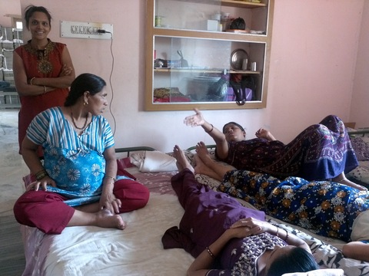
Questions!

Slide 31
Thank You!

