Slide 1
Use of I.T. and preparation of a dashboard for the U.P. irrigation Dept.
Sai Sreemukh Kardas
14th July, 2013
Notes:
Graphics, tables, and graphs
Keep it simple: If possible, use consistent, non-distracting styles and colors.
Label all graphs and tables.

Slide 2
Contents
What a dashboard means in this context..
List of modules
What the project is all about..
Project Overview
Research Methodology for the project
Field visits and Mentor Discussion
Key Findings
Results and Discussions
Recommendations, their scope and Strategy for Implementation
Scope for future work

Slide 3
What a dashboard means in this context..
Software
Provides Control to UPID
26 modules
An attempt to modernise the system
Technical personnel monitor the dashboard

Slide 4
List of Modules
Question Management
Asset Management
Audit and Draft Para
Budget
Contract Management
Litigation Management
HRMS
Financial Accounting
Payroll Accounting
Procurement and Tender
Revenue
Store Accounting
Monitoring and Evaluation
Construction of Projects
Dam Safety Monitoring
Design of Works
Drainage Improvement and Maintenance
Flood Control and Management
Investigation and Planning
Irrigation and Water Management
Mechanical Works
Research Activities
Support (Diary and Dispatch, File Tracking, Document, Team)
General Administration
IT Management
Intranet

Slide 5
What the project is all about..
UPID is facing difficulties in implementing the dashboard
Tried to find solutions
Solutions are in the form of models and systems
Suggestions encompassing some general problems as well
Notes:
Define the goals and objectives of this project. What is it that we are trying to achieve out of this project?

Slide 6
PROJECT OVERVIEW

Slide 7
PROBLEMS
Dashboard Specific Problems:
Data Collection is very low – 10%
Network Problems
General Problems:
Inefficiency
Disorganized
Lack of motivation in employees
Corruption
Ineffectual attitude towards farmers

Slide 8
GOALS & OBJECTIVES
The overall objective of this project is straightforward – suggestion of measures that can improve the operation of UPID in general, and the dashboard in particular. An exhaustive list of the objectives can be enumerated in the following way:
Devising a system which employs CPM in an organized manner
Database management of irrigation projects
Exploring the possibility of using wireless network for the dashboard
Investigation of a complaint system for canals
Employee performance evaluation

Slide 9
RESEARCH METHODOLOGY

Slide 10
Throughout my research I had to constantly learn new concepts, methods and algorithms, pertaining to Computer Science and Project Management. Also, I had to know about irrigation in general, and the irrigation department of U.P. in particular.
Mentor Discussions
Field Visits
Literature Review
Notes:
Explain how research is done and outlines how the data was collected to support your findings?
Outline what methodology you used in your research i.e. what you did and how you did it.

Slide 11
Mentor Discussions
Scope
Purpose
Situation
Sources
Motivation

Slide 12
Field Visits
As problems became apparent – objectives became clearer
Status of the dashboard – facilities and issues
Caution

Slide 13
Literature Review
Project Management Tools – The Critical Path method
Computer Networks – Wireless
Database Management – Irrigation Projects
Employee Organisational Hierarchy

Slide 14
FIELD VISITS AND MENTOR DISCUSSIONS

Slide 15
Date | Name | Designation | Institution | Topic of Discussion*
4th June’ 13 | Shri Arvind Kumar Gupta | Chief Engineer | UPID | Irrigation processes in general – Canal Irrigation in particular
4th June’ 13 | Shri Sanjay Mataray | Assistant Engineer | UPID | Roasters and water distribution mechanism
27th June’ 13 | Shri Ambuj Dwivedi | Executive Engineer | UPID | Problems in the implementation of dashboard and general employee mentality
27th June’ 13 | Shri Mayur Maheshwari | Special Secretary | UPID | Integration of financial aspects with project sites

Slide 16
28th June’ 13 | Shri Prateek Mai Khare | Technical team member, Dashboard |  | Technical details of the dashboard and difficulties being faced
28th June’ 13 | Shri Dev Singh | Technical team member, Dashboard |  | Technical details of the dashboard and difficulties being faced
28th June’ 13 | Shri Rajat | Technical team member, Dashboard |  | Technical details of the dashboard and difficulties being faced
28th June’ 13 | Shri Rajesh Shukla | Assistant Engineer | UPID | Participatory Irrigation Management

Slide 17
KEY FINDINGS

Slide 18
Status of dashboard
Complaint system exists only for tube wells
No performance evaluation system
System of usage of CPM is suspect
Roaster implementation is pathetic
W.U.A.s are in a very bad shape
Underachieving Department
Notes:
In this section report some facts and key findings made by you either by the analysis of the data collected by you or thorough field visits or literature survey

Slide 19
RESULTS & DISCUSSIONS

Slide 20
Database Management
Storage of information pertaining to irrigation projects is very disorganized
There is no fixed pattern
Employed Relational database model
Entity-Relationship Diagrams
Set of tables related to each other

Slide 21
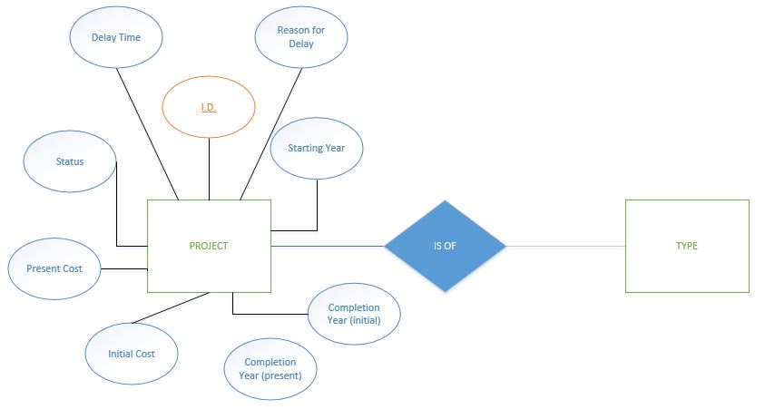
Entity Relationship Model

Slide 22
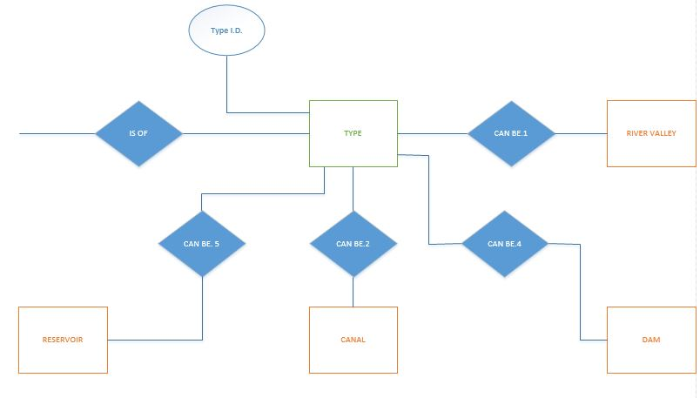

Slide 23
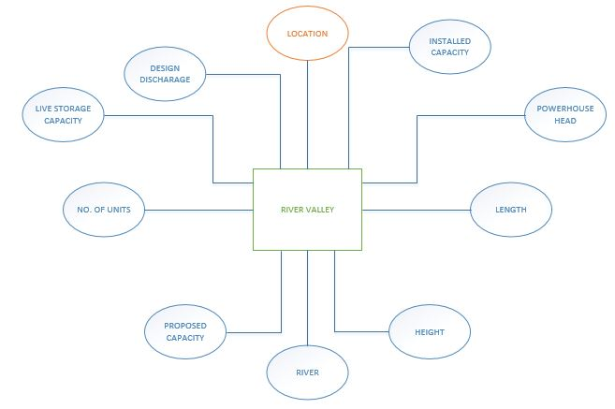

Slide 24
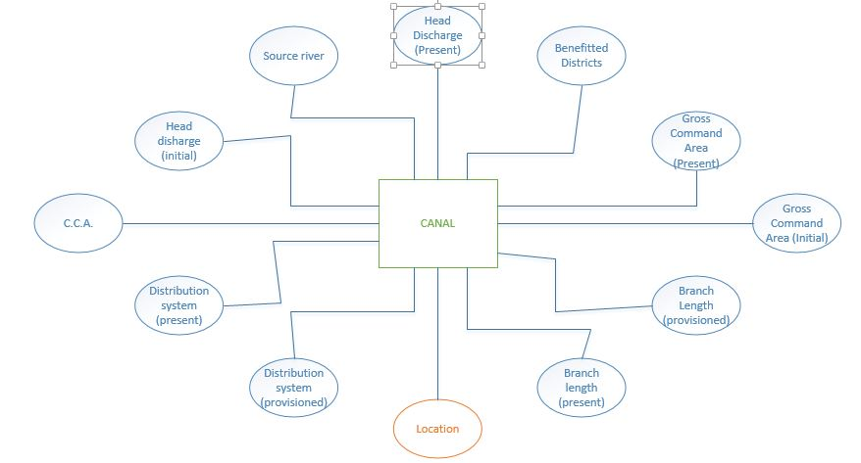

Slide 25
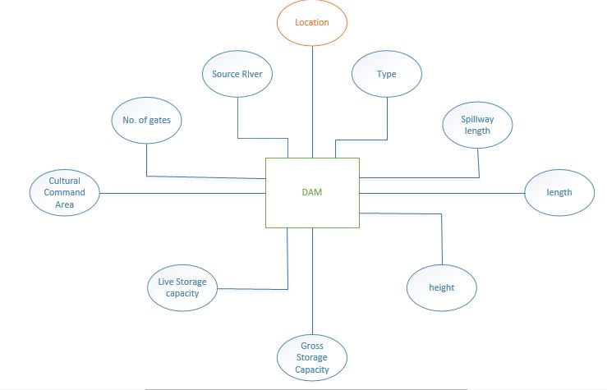

Slide 26
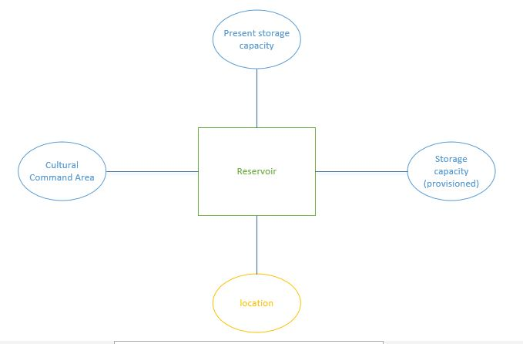

Slide 27
Project Analysis System - CPM
Network Analysis is an elegant way to keep track of the project.
The Critical Path Method is a very useful tool. It helps us to estimate the shortest possible completion time of a project.
Very versatile and effective.
Widespread use in fields like aerospace, defence, product development, engineering etc.
Acclimatised myself to the method. Ready to implement it on any project.

Slide 28
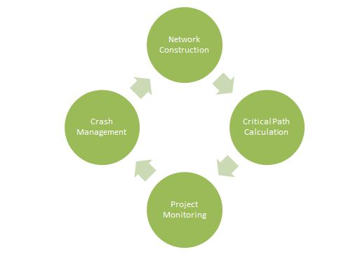
The System

Slide 29
Prerequisites for network construction
Information that is required before constructing the project network:
Activity List
Individual activity durations
Estimated using D = Q/NP
Q = Quantity of work; N = Number of resources; P = Productivity
Precedence relationships

Slide 30
Critical Path Calculation
Example Project:

Slide 31
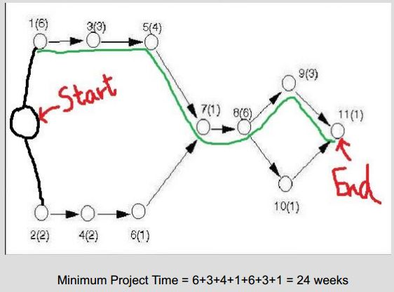
Solution:

Slide 32
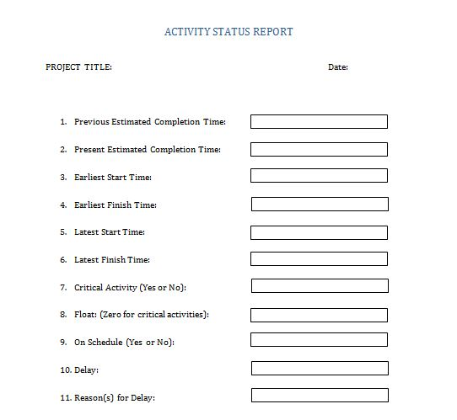
Activity Status Report

Slide 33
Wireless Networking
The size of the network of the dashboard:
20 sq. km.
1000 machines
Wireless is feasible for such a network
Two famous types of wireless :
IEEE 802.11 or Wireless Ethernet
Bluetooth

Slide 34
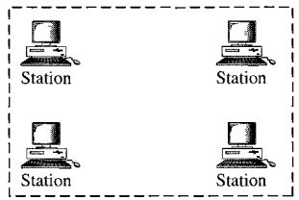
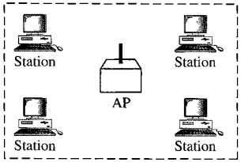
IEEE 802.11
Basic Service Set: Consists of mobile or stationary stations with an optional ‘access point’.
Ad-Hoc : No Access Point
Infrastructure : With Access Point

Slide 35
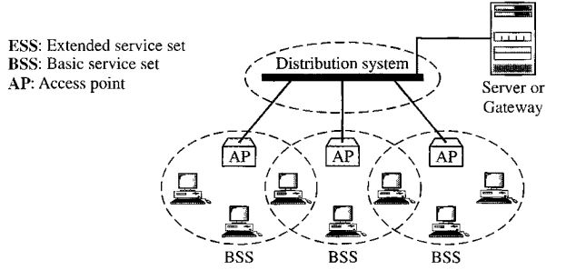
Extended Service Set: It is made up of 2 or more BSSs with APs.

Slide 36
RECOMMENDATIONS

Slide 37
Recommendation #1
Recommendation: Design and maintain a database exclusively storing data pertaining to irrigation projects.
Reasons
Disorganized storage of data – Time consuming process to access small amount of data.
Scope
Storage of data pertaining to irrigation projects – Quick access to records.
Strategy
Design the database on the basis of the 3 levels of abstraction – Physical, Logical and View. Classify the irrigation projects into all possible cases and also define the parameters of each type of project. Construct the database using the 'Relational Database model'.
Notes:
In this section, mention the recommendations and if implemented what would be the scope of improvement and what strategy you have in mind for implementing these recommendations.

Slide 38
Recommendation #2
Recommendation: Devise a system which employs the CPM in an organized and formulated manner
Reasons
The method is used by project related officials in the department. But the manner and form of the method that they use is suspect. This is evident from the incessant delays and roadblocks that plague irrigation projects. It is not uncommon to find projects which are delayed by decades.
Scope
Reduction both in the number and durations of delays in the course of project completion that have been plaguing the department. Cost of projects will also not rise exponentially.
Strategy
Design the system – Propose this system to the engineers of the department – Find out their opinion on matters like relevance and feasibility – Fine tune the system after incorporating the changes.

Slide 39
Recommendation #3
Recommendation: Expand the complaint system to canals
Reasons
The system right now in place – catering to the grievances pertaining to tube wells – is functioning quite efficiently. Canal irrigation is not in a very healthy situation, with issues relating to water availability and inaccurate roaster implementation causing a lot of problems to the poor farmers.
Scope
Farmers get some much needed leverage. Problems which are now left unattended to will gain some attention. Some, if not all complaints, will be satisfactorily subdued. Improvement in the system of canal irrigation.
Strategy
Since the network of canals is a huge one, a fairly concrete and extensive strategy is required for implementing this system. For a start, one could consider including W.U.A. s into the scheme of things. Complaints will not be relayed directly to the government office, but instead, will be received by the complaint centre via the local W.U.A.

Slide 40
Recommendation #4
Recommendation: Design a performance evaluation system for the employees of UPID in order to increase the efficiency of the department
Reasons
Inefficient working patterns of the employees hurting the functioning of the department. Lack of motivation among the employees a cause of concern.
Scope
Increased productivity – implying increased efficiency (resources remaining the same). Healthy working environment.
Strategy
Standardize the data of the employees that needs to be stored for evaluating performance. The parameters of this data are budget utilisation, financial and physical progress of the individual employees. Develop required software. Start the system on a small scale and - after monitoring and evaluation of the effectiveness of this system – fine tune the system and – finally implement on a large scale i.e. throughout the whole department.

Slide 41
Recommendation #5
Recommendation: Develop an Online Fund Flow mechanism for the department in order to curb corruption
Reasons
Corruption and Fraudulence rampant in the department..
Scope
Reduction in corruption – Efficient usage of funds.
Strategy
The data of the employees that will be collected for the dashboard will be integrated with this system. Software system must be developed to include certain functionalities. Establish an enforcing authority. Every person is given an account and password. Employees must submit their fund usage in appropriately regular intervals. There should not be provisions for delayed submissions of these reports. The total sum of the funds utilized will be calculated and cross-referenced. Any discrepancies will be immediately apparent.

Slide 42
SCOPE FOR FUTURE WORK

Slide 43
CPM system can be fine-tuned
Only crude ideas have been presented – designing process of these models still a major task
Concrete modelling will unearth even more issues and realities
Designing of these models will require extensive and comprehensive study of each of the domains mentioned
Feasibility still not validated – seemingly robust models might end up being of no practical significance – confined to the realms of a utopian society.

Slide 44
Thank you very much!

Slide 45
Suggestions and Questions

