Slide 1
Soft Skills Training to Marginalized Youth: Issues and Challenges
Osheen Tripathi Mentor : Shri Atul Bhatnagar, COO, NSDC
Notes:
Graphics, tables, and graphs
Keep it simple: If possible, use consistent, non-distracting styles and colors.
Label all graphs and tables.

Slide 2
Age Wise Distribution Of Population

Slide 3
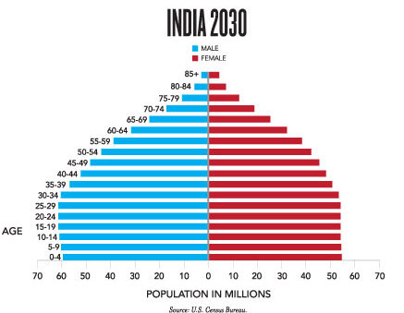
Demographic bulge of India

Slide 4
Skill Development Recognized as a Policy Objective
Eleventh Plan
National Skill Development Mission
‘Coordinated Action on Skill Development’
PM’s National Council
National Skill Development Cooperation Board (NSDCB)
National Skill Development Corporation
VISION: Create 500 million skilled people by 2022 by skill systems, which are inclusive
Three-tier institutional structure created

Slide 5
Goals and Objectives
Showing importance of soft skills in present employment scenario
Industry perspective
Trainers and Trainees’ perspective
Identify hurdles in soft skills training
Demand side
Supply side

Slide 6
Goals and Objectives
Identifying soft skills relevant to sectors being studied
Sector specific skills
Developing framework for soft skills training, measurement and assessment
New initiatives
Incorporation in existing framework
Desirable personality traits

Slide 7
Research Methodology
Literature Review -existing frameworks -need for development - skill sets
Field Visits -training centres -industry visits
Survey -job search sites -industry -trainers -students
Meetings with and interviews of experts in the field

Slide 8
Field visits and Mentor Discussion
Sr. N. | Date and time | Mentor/Person Interviewed | Place | Aim | Findings
1. | 27th May 2013 | Shri Atul Bhatnagar, | NSDC Office | Introduction to project | History of skill development, initiatives taken in India and abroad, working of NSDC
2. | 5th June 2013 | Shri Atul Bhatnagar, NSDC | NSDC Office | Discussion of research methodology | Field visits to be conducted, survey questionnaire, aspects to be researched; contacts
3. | 7th June 2013 | Shri S.K. Rai, Gras Academy | Gzb Centre | Information about training procedure | Details of training modules and suggestions; success stories
4. | 11th June 2013 | Ms Shreya Singh, NYJL NIIT | Paharganj Centre | Information about training | Insights into training modules, hurdles faced, placement scenario.
Notes:
Mention all the visits, meetings and interviews along with the key findings, you have done so far, in their respective rows.

Slide 9
Field visits and Mentor Discussion
Sr. N. | Date and time | Mentor/Person Interviewed | Place | Aim | Findings
1. | 21st June 2013 | Me R.K. Jha, Aide et Action | Khajoori Khas | Information about training procedure | Unique training model, support system to students-pre and post placement
2. | 3rd July 2013 | Mr Shakti Anand, Deepalaya | Okhla Phase 2 | Information about training procedure | School level training, vocational training module and placements
3. | 25th June 2013 | Mr Ariaravelan K | Aparajitha Foundation | Information about TTT program | Successful model for school level inclusion and various features
4. | 6th July 2013 | Me Padmanaban | Aparajitha Foundation | Information about TTT program | Details about expansion plans and activities

Slide 10
Key Findings- Literature Review
Importance of soft skills
Employability gap at entry level
Demand-supply gap of trainers
Government initiatives in this regard
Initiatives in foreign countries
Existing training institutes and their course structures and training modules- sectors served
Skill gaps exist in the two sectors being studied (from reports about employment scenario in 2022)
Notes:
In this section report some facts and key findings made by you either by the analysis of the data collected by you or thorough field visits or literature survey

Slide 11
Key Findings-Field Visits, Meetings and Interviews
Ground level situation
Course structures and training modules
Attitude of students and response to soft skills training
Hurdles faced- demand side and supply side
Employer attitudes
Existing Efforts
Trainers’ certification, training and selection
Sector- wise scenario in training institutes
Practical suggestions on possible initiatives

Slide 12
Field Visit to Khajoori Khas
Innovative Curriculum
Industrial Visits
Pre-placement guidance
Post placement support
Mobilization and orientation
PROCESS
A SUCCESSFUL MODEL

Slide 13
Results and Discussions
Soft skills important
Students facing interviews
Career progression and income outcomes
Productivity and efficiency- in-house training
Employer’s survey indicates employability gap

Slide 14
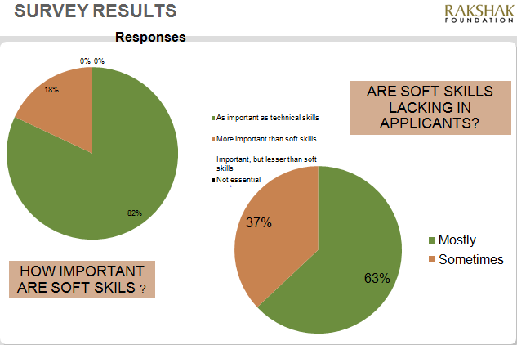

Slide 15
Results and Discussions
Scarce supply of trainers
No incorporation in school curriculum
Formal incorporation absent; scattered examples
ROADBLOCKS
Additional hurdles faced unique to target group

Slide 16
Results and Discussions
The positive side- improving scenario
NSDA affiliates- centres catering to marginalized youth impart soft skills training for placement assistance
Unique partnerships between local/State Governments in Tamil Nadu and Andhra Pradesh
Students recognition and accordance of aspirational value; independent institutes

Slide 17
Recommendation #1
NSDC Funding and government support
1
Proposal evaluation process-criteria of approval and acceptance of proposal
2
Soft skills training a part of the compulsory criteria
3
Better soft skill development- Mutual benefit for trainees, trainers, employers and Government
Benefit to employers
Benefit to institutes
Benefit to trainees

Slide 18
Recommendation #2
Expanding Reach- Involving Schools
Connecting with school boards
Government initiatives
Partnerships with NGOs and relevant agencies for rolling out programs in Govt. schools
Encouraging private initiatives
Incorporation in school curriculum
Private schoosl and NGOs taking up life skills training
‘Hygiene Skills’ developed’. Positive fallout
Formulation of curriculum
Teacher training

Slide 19
Success Story- Thalir Thiran Thittam
Pilot project in Madurai District
State Government
Aparajitha Foundation
Successful Model
Teacher training
Mobilization
Expansion
Other districts
Adoption by other states
Interactive activities
Higher classes
Video lectures

Slide 20
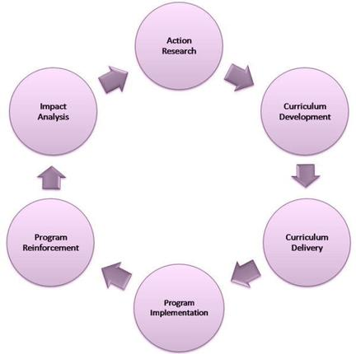
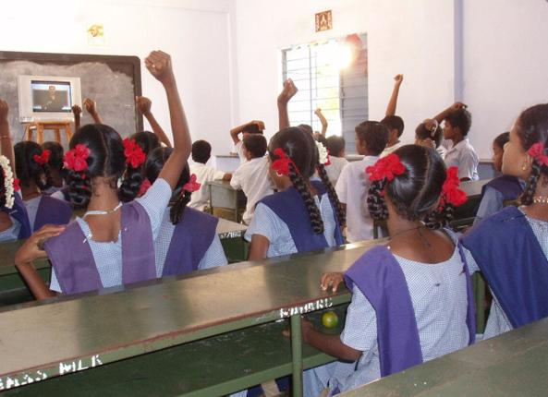
Lessons from outside the textbook
TTT Methodology
Participatory learning
Gujarat follows TN

Slide 21
Recommendation #3
Enervating policy initiatives- SSCs and NOS
Sector Skill Councils- governs skill development initiatives
National Occupational Standards (NOS)
SSCs to govern the skill development initiatives of 21 target sectors of the NSDA; formulate the National Occupational Standards. - Determining and defining requirements -Regulation of institutes -Trainer requirements and certification

Slide 22
National Occupational Standards
Curriculum Design
Standardization and certification
Awareness about the same and enforcement through set of guidelines
Industrial visits, Pre and post placement support

Slide 23
Recommendation #4
Addressing demand-supply mismatch of trainers
Problem
Absence of certification of trainers
DIfferent practices being followed
Solution
Creation of certification criteria for ToT
Complusory accreditation a pre-requisite
Method
Development of standard norms of training by SSCs
Promotion of certification of trainers an d institutes by SSCs (on lines of standards like ISO)

Slide 24
Recommendation #4
Addressing demand supply mismatch of trainers
Standards for assessment
Standardization of courses for trainers
Investment in training infrastructure
Additional Issues

Slide 25
Thank you
Questions? Feedback?

