Slide 1
Project Status Report
Name: Shashwat
Institute: IIT Roorkee
Mentor Name: Smt. Arti Ahuja
Institute: IAS
Presentation Date: July 13, 2012
Notes:
Graphics, tables, and graphs
Keep it simple: If possible, use consistent, non-distracting styles and colors.
Label all graphs and tables.

Slide 2
Production and Marketing of Handicraft Goods – Challenges and Opportunities

Slide 3
Contents
Project Overview
What is the project about?
Goals and Objectives
Scope of the project
Your approach towards the project
Field visits and Mentor Discussion
Key Findings
Results and Discussions
Recommendations, their scope and Flow chart (Strategy) for Implementation
Suggestions for future work

Slide 4
Project Overview
The project is aimed to bring up some ideas for the betterment of the artisans involved in the handicraft and handloom industry of Odisha.
These industries have taken a background in the current era of industrialization and globalization.
They hold a lot of potential for employment in the rural areas.
There is a need to seriously address their problems mainly related to
raw material procurement,
manufacturing methods and techniques,
design patterns,
marketing strategies and getting proper value of their product from the market.
The project also takes a overview of the lacquer craft industry in Odisha.
Notes:
Project Overview
What is the project about?
Define the goal of this project
Define the scope of this project

Slide 5
Goals and Objectives
To study the handicrafts of Odisha and get an idea of the market trend of this industry.
To prepare a list of the handicraft items and their categorization.
To study the marketing strategies for these items and find out new marketing channels.
To find out reasons for the inefficiency of the current policies and suggest modifications.
To prepare a list of the organizations which are currently working with the handicraft artisans and industry.

Slide 6
Scope of the project
The project mainly studies the situation of the artisans of Odisha.
The problems of local artisans of kanpur have been studied and local officials have been contacted to get an idea of the overall situation here.
The results of my study would be applicable to the local handloom industries as well.
A special study of the lacquer craft has also been taken up.

Slide 7
Your Approach Towards the Project
Understanding the situation by studying the leather handicraft industry of Kanpur and going through the literature of Odisha handicraft industry.
I listed the areas in which the solution could be found for the overall improvement.
I researched government policies have already been formulated to address these problems. I tried to figure out the reasons of their inefficiency.
Based on this knowledge and the prevalent situation, I came up with ideas either for slight modification or a different way of implementation.
I interacted with many NGOs of Odisha and have also prepared a list of such organizations
Notes:
In this slide, mention: after understanding the problem how you decided to approach it?

Slide 8
Field visits, Meetings and Interviews
Sr. No. | Date and time | Person or Organization | Place | Aim | Findings
1. | 31 May | Mr. K. N. Singh | kanpur | To study the local handicraft industry | Got to know about the various kinds of support that his NGO provides to the local artisans
2. | 1 June | Ms. Bhawna Gupta | Via telephone | To know her view point as a trainer | View of a fashion tech student.
3. | 7 June | Mr. Y. S. Garg, Mr. Alok Srivastava | Via telephone | To know the facilities provided for export | Got a rough idea of the facilities provided to these poor people for exporting.

Slide 9
Sr. No. | Date and time | Person or Organization | Place | Aim | Findings
4. | 21 June | Mr. Kesu Das | Via telephone | To know about the lacquer industry of Odisha | He gave an overview of the steps and requirements of the industry and the situation of the artisans involved.
5. | 26 June | Mr. Ashok Kumar Sahoo | Via telephone | To discuss the marketing strategies | He told about various problems faced by the artisans in marketing.

Slide 10
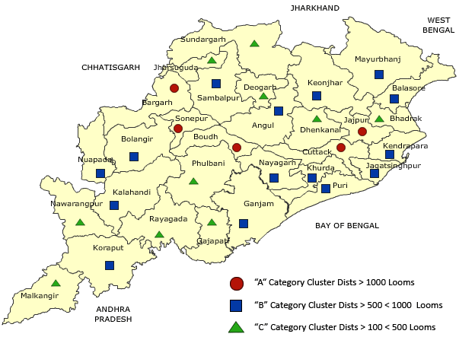
Key Findings
Notes:
Categorized under 4 categories

Slide 11
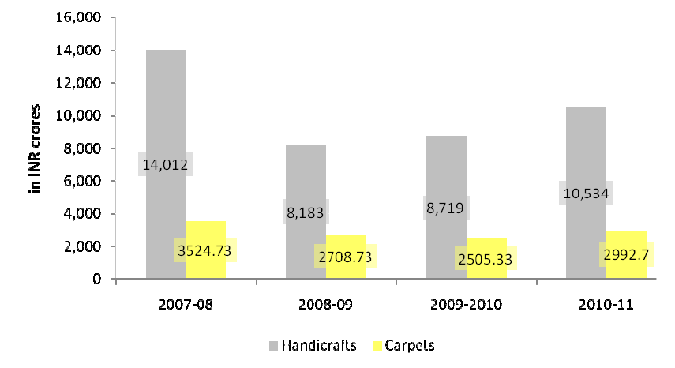
Key Findings
Export of the handicraft goods from India
Notes:
In this section report some facts and key findings made by you either by the analysis of the data collected by you or thorough field visits or literature survey

Slide 12
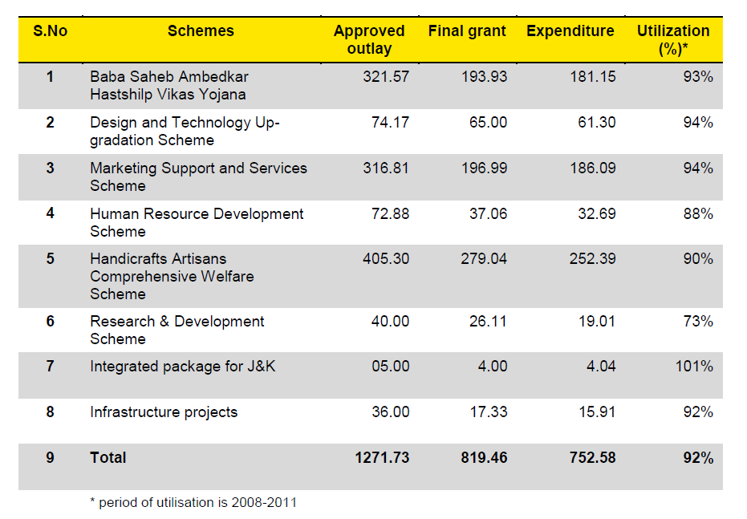
Key Findings
Schemes of government of India
Notes:
In this section report some facts and key findings made by you either by the analysis of the data collected by you or thorough field visits or literature survey

Slide 13
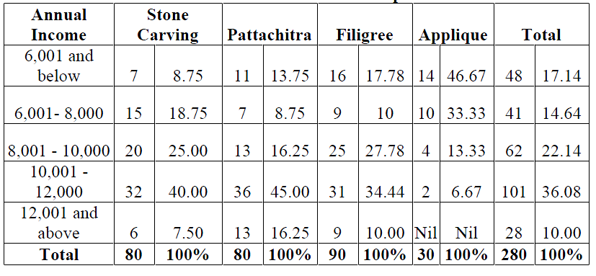
Key Findings
But
Notes:
In this section report some facts and key findings made by you either by the analysis of the data collected by you or thorough field visits or literature survey

Slide 14
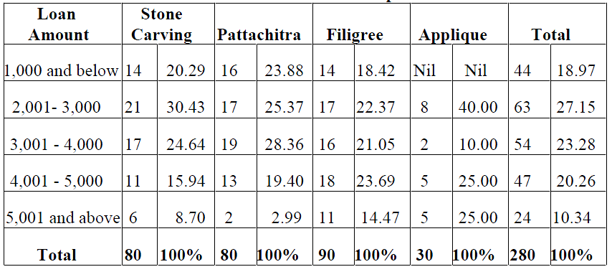
Key Findings
But
Notes:
In this section report some facts and key findings made by you either by the analysis of the data collected by you or thorough field visits or literature survey

Slide 15
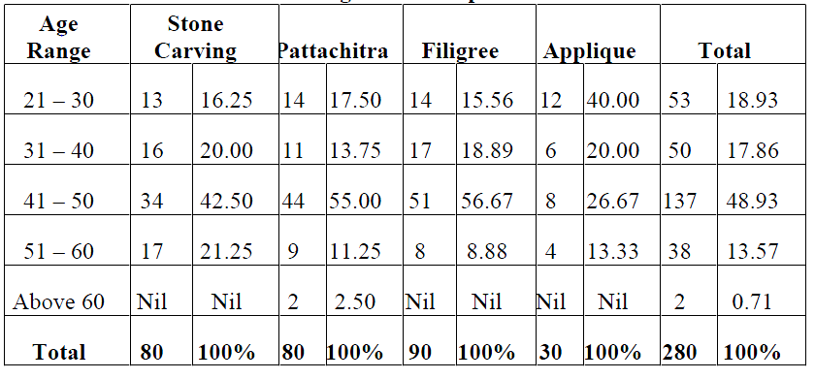
Key Findings
But
Notes:
In this section report some facts and key findings made by you either by the analysis of the data collected by you or thorough field visits or literature survey

Slide 16
Key Findings
The sector is highly unorganized.
Three different methods of production-
Independent weaver producer
Co-operative form of production
Attached weavers working under private master weavers-cum-merchant capitalists
About half of the artisans work under master craftsmen and dealers, where they are exploited.
The co operative system of working has not been a success in the state. The industry was also hit by the policies of globalization.
Notes:
In this section report some facts and key findings made by you either by the analysis of the data collected by you or thorough field visits or literature survey

Slide 17
Key Findings
The NGOs have been able to provide benefit to these sections from the governmental policies.
The industry, however, holds a lot of potential for the rural sector
because it is labor intensive ,
initial capital required is very small,
youngsters get trained in the art in their family itself;
which would help in stopping migration from rural to urban area and preserve the traditional crafts.
Notes:
In this section report some facts and key findings made by you either by the analysis of the data collected by you or thorough field visits or literature survey

Slide 18
Results and Discussions
The main reason is - unorganized nature of this industry and low literacy rate of the artisans.
Technologies used are very old thus causing drudgery and low productivity.
Quality of raw material being used in the industry is not approved and there are no set standards for final products.
No attention is paid to packaging of products, hence low export.
Limited marketing potential in areas of production.
The youth belonging to these families must take up the responsibility of managing the business and start using newer technologies.
The lacquer craft industry is on the verge of extinction.
Notes:
In this section talk about the significance of key findings, discuss their importance for formulation of strategies and how they helped you in achieving your targets.
Discuss the role of the data collected by you and how the analysis of it helped you in getting the better picture of the problem at hand or helped in achieving your goals.

Slide 19
Gap Analysis
Sufficient government policies have been formulated.
Still the benefits have not reached the targeted artisans.
The reason-
Government needs to pump in more money in these schemes.
Government needs to use intensive techniques to publicize the schemes.
Government needs to assure artisans and gain their confidence.
Notes:
Same guidelines as in the final report section

Slide 20
1) Recommendations
Lacquer craft industry
Languishing craft in Orissa.
Dismal situation of artisans – poverty, unavailability of raw materials
Steps required
Construction of raw material banks in Balasore and Nawrangpur districts
Subsidizing the raw material.
Setting up more raw material processing plants.
Incentivizing formation of all women Self Help Groups.
Invitation for display of items in other states.
Notes:
In this section, mention the recommendations and if implemented what would be the scope of improvement and what strategy you have in mind for implementing these recommendations.

Slide 21
Implementation
Allotted funds under the “Infrastructure and Technology Development scheme” shall be utilized for setting up the bank and processing plants.
The work shall be handed over to the authorities working for handicrafts in the state.
Notes:
In this section, mention the recommendations and if implemented what would be the scope of improvement and what strategy you have in mind for implementing these recommendations.

Slide 22
2) Recommendations
Hastshilp “Haat”s
Urban Haat Scheme and Mini Haat Scheme
Steps required
Small haats of not more than 20 units.
Set up at major tourist spots.
Installations made of bamboo which shall be aesthetically appealing and ethnic
Invitation to artisans from different clusters.
Rotation of allotment of shops among the artisans from each cluster.
Subsidized rent and arrangement for stay of the artisans.
Notes:
In this section, mention the recommendations and if implemented what would be the scope of improvement and what strategy you have in mind for implementing these recommendations.

Slide 23
Implementation
Similar to the Urban Haat Scheme, funds shall be allotted for setting up Hastshilp Haats.
Regional Directors (Office of Development Commissioner, handicrafts) shall approve projects after getting proper inspection.
The agencies like Handicraft/ Handloom Development Corporations, Tourist Development Corporations, SPV, TPO Bodies with sufficient financial resources and organizational capacity to implement such projects shall be eligible for assistance
Notes:
In this section, mention the recommendations and if implemented what would be the scope of improvement and what strategy you have in mind for implementing these recommendations.

Slide 24
3) Recommendations
Brand building & online advertisement
Proposed brand “Handcrafted in India”
Steps required
Developing a brand that shall cover all the handicrafts of India
All the exports shall be done under a single name.
This brand shall be used for building warehouses in foreign, for packaging and labeling the goods.
Organizations like IBEF shall use this brand for publicity.
Notes:
In this section, mention the recommendations and if implemented what would be the scope of improvement and what strategy you have in mind for implementing these recommendations.

Slide 25
Implementation
The brand name development campaign shall be funded by the Ministry of textiles.
Institutions like IBEF shall take up the handicraft products more extensively for publicity.
The advertisement shall also be done online through various government websites
For domestic publicity, the Railways department shall display interesting graphics on its coaches. It shall be done zone wise.
Publicity measures shall be taken targeting women, like television infomercials.
Notes:
In this section, mention the recommendations and if implemented what would be the scope of improvement and what strategy you have in mind for implementing these recommendations.

Slide 26
4) Recommendations
Setting standards and quality check (for export)
There are no rules to check the standard of the exported handicraft goods, neither there are any specific standards.
No check of packaging of the products and no such facility.
Steps required
Detailed study of which handicrafts can have market outside India.
There shall be a standard set and the artisans shall be made aware of these. (product specific)
Packaging facility for a group of clusters.
Notes:
In this section, mention the recommendations and if implemented what would be the scope of improvement and what strategy you have in mind for implementing these recommendations.

Slide 27
Implementation
The Export Promotion Council for Handicrafts must come up with the proposed interventions.
Other export promotion councils like CEPC shall also help with these steps.
Notes:
In this section, mention the recommendations and if implemented what would be the scope of improvement and what strategy you have in mind for implementing these recommendations.

Slide 28
5) Recommendations
Training Artisans with contemporary designs (skills) – Interaction with students
The government trains artisans for acquiring knowledge of the technique and also for skill up gradation, currently being done through established institutions, training in innovative design, through guru shishya parampara and conducting seminars and workshops.
Steps required
Fashion technology students shall be encouraged to train the artisans which shall be an internship for them.
Students doing so shall be given extra credit in their college course and companies hiring them shall encourage such students.
Display of developed design in institutions and integration with fashion industry.
Notes:
In this section, mention the recommendations and if implemented what would be the scope of improvement and what strategy you have in mind for implementing these recommendations.

Slide 29
Implementation
The ministry of textiles and the ministry of education shall jointly work on these policies.
NGOs shall be the medium that would associate the students with the artisans.
Collaboration between NGOs and fashion institutions.
Notes:
In this section, mention the recommendations and if implemented what would be the scope of improvement and what strategy you have in mind for implementing these recommendations.

Slide 30
6) Recommendations
Training Artisans in administration (capacity building)
The government also trains artisans & NGOs, potential entrepreneur and SHG leaders in non-technical skills such as micro finance/ entrepreneurship development/ preparation for business plans/ preparation of project reports/ packaging/ export procedures/ Documentation etc.
Steps required
All the artisans between 18 to 30 years of age shall be given free training in business planning and management at micro level by specialized event management trainers.
Regular seminars shall be held to impart knowledge about the latest policies and schemes meant for benefitting the artisans.
Promotion of primary education among artisans.
Notes:
In this section, mention the recommendations and if implemented what would be the scope of improvement and what strategy you have in mind for implementing these recommendations.

Slide 31
Implementation
The office of the development commissioner (handicrafts) shall be responsible for the implementation of the same.
They should organize seminars by calling in expertise from management field and arrange for the required infrastructure.
Notes:
In this section, mention the recommendations and if implemented what would be the scope of improvement and what strategy you have in mind for implementing these recommendations.

Slide 32
7) Recommendations
Organization
The “Small Industry cluster development Program” covers only a few clusters and has been formulated for developing the existing clusters.
Steps required
The artisans shall be encouraged to form clusters so that they are able to manage the marketing of their products in a better way.
The government shall also encourage the artisans to form co-operative societies.
The clusters shall be divided based on their sizes as small, medium or large.
Large clusters shall set up an office to manage their affairs while small clusters can make a group and set up office common for all of them.
Notes:
In this section, mention the recommendations and if implemented what would be the scope of improvement and what strategy you have in mind for implementing these recommendations.

Slide 33
Implementation
All the organization shall encourage the formation of clusters.
The categorization of the clusters shall be done by the main office of the development officer (handicrafts) based on data collected by other appropriate agencies.
Notes:
In this section, mention the recommendations and if implemented what would be the scope of improvement and what strategy you have in mind for implementing these recommendations.

Slide 34
Suggestions for future work
Further studies shall take up specific areas in specific states where artisans work with a specific handicrafts.
The area shall be surveyed for what the needs of the artisans are and what are the policies that need to be implemented that area which would be able to improve the condition.
Notes:
Given the limited time and enormity of the scope of the assigned projects, there are bound to be many aspects of the problems that could not be adequately or at all investigated. You should consult your mentor and should list all such aspects for further investigation

Slide 35
Questions????
Notes:
* If any of these issues caused a schedule delay or need to be discussed further, include details in next slide.

Slide 36
Thank You
Notes:
* If any of these issues caused a schedule delay or need to be discussed further, include details in next slide.

