Slide 1
Scams in Capital Markets
Savings=Investment
Keynesian/ National Accounts view
Lydia De Salma
Madras School of Economics
Mentor: Shri Ritesh Singh, IAS
July 14, 2013
Notes:
Graphics, tables, and graphs
Keep it simple: If possible, use consistent, non-distracting styles and colors.
Label all graphs and tables.

Slide 2
Structure of the project
Methodology
Literature Review
Field Visits
Introduction
Background Information
Scope of the project
Goals and objectives
Recommendations
Results and Discussions
Government Efforts
SEBI
MCA
GoI
Case Study: Saradha scam in West Bengal

Slide 3
Introduction to Capital Markets
Financial Market
Capital Market
Long-term finance
Money Market
Short-term finance
Call money, collateral loans,
acceptances,
bills of exchange
Stocks, shares, debentures, bonds,
securities

Slide 4
Capital Market Scams
‘vanishing’ after raising money through public offers
illegal collection of deposits
floating sham Collective Investment Schemes
Collecting money by posing as Non-Banking Financial Companies
Restoring to ‘Ponzy’ or money circulation schemes

Slide 5
Capital Market Scams
Fraudulent Schemes
Pyramid Schemes
Direct Selling Companies
Ponzi Schemes
Chit-funds
MLMs
CIS

Slide 6
Working of a Pyramid Scheme

Slide 7
Public Investment
Do not utilise
No business
(all owner profits)
initially pays return but not in the LR
SCAM
PONZI SCHEME
CIS, illegal MLMs, direct selling companies, chit funds

Slide 8
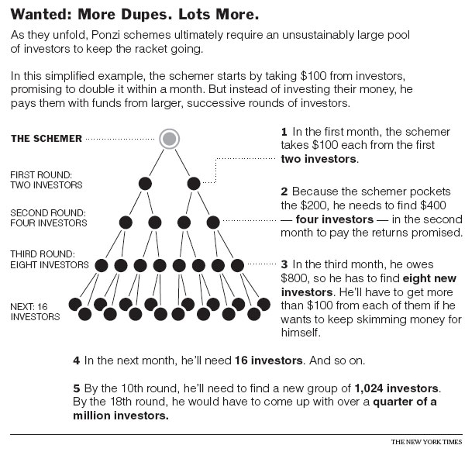
How Ponzi Schemes work

Slide 9
Hint of a Ponzi Scheme
Offering very high, guaranteed return with no risk involved
Smooth flow of positive returns
Raw investment, no service required
Lack of proper documents
No direct contact with the company but investment through agents
Offer pitched as exclusive
Offer from a known person
Unregistered or ‘exempt’ investments
Incomplete information and relatively incomprehensible procedure
Company name chosen to engender nobility, strength and other salient attitudes
Unbusiness-like conduct
No reliance on word of mouth

Slide 10
Goals and Objectives
Steps for registration of a company in India
Modus Operandi of fake companies
Case Study: Saradha Group Ponzi Scheme
Steps taken by SEBI and other regulatory authority
punishment of fraudulent companies in India
Formulating strategies to curb them

Slide 11
Methodology
Mentor Meeting
Field Visit
Literature Review

Slide 12
Research Methodology:
Literature Review
Acts, Regulations, Amendments, Monitoring, Investigation, Roles, Laws and provisions, Mentor
GoI
SEBI
MCA
RBI

Slide 13
Field visits
Sr. No. | Date and time | Person or Organization | Place | Aim | Findings
1 | 06/06/2013 - 08/06/2013 | Interviewed the investors of the Saradha Group and also some of the agents. | Field visit to Murshidabad district in West Bengal | To understand why and how people invest in chit-funds and related companies. | The lack of knowledge about the functioning of the capital market, poor availability of banks, greed of high returns and also emotional attachment to the agents.
2 | 08/06/2013 - 10/06/2013 | Survey of the victims of the Saradha scam | Field visit to Uttar Dinajpur and Medinipur districts in West Bengal | To understand the effect of the scam on the investors. | People deposited in the company in bulk amount. It was not difficult to find them since almost every second person I met knew many other investors. Overall, it made a major impact on the people and economy.
3 | 11/06/2013 - 12/06/2013 | Spoke with the investors and agents | Field visit to North 24 Parganas and Kolkata in West Bengal | To understand the modus operandi of the company that it easily lured the investors. | People were lured by the high returns offered. The company was so popular in West Bengal and nearby areas that investors had complete faith in the company.

Slide 14
Mentor Discussion
Sr. No. | Date and time | Person or Organization | Place | Aim | Findings
1 | May 21, 2013 10.30 am | Mentor: Shri Ritesh Singh | Anusandhan Bhavan, New Delhi | Project Discussion | To narrow down the project to only Ponzi Schemes in India with focus on Saradha Group in West Bengal.
2 | May 30,2013 11 am | Mentor: Shri Ritesh Singh | Anusandhan Bhavan, New Delhi | Feedback on the work done and Questionnaire discussion for field visit | To understand the modus operandi of the Saradha Group and its effects on the economy. Field visit was suggested to West Bengal.
3 | June 25, 2013 4.15 PM | Mentor: Shri Ritesh Singh | Anusandhan Bhavan, New Delhi | Review of field visit and mid-term report | Feedback on the recommendations and the mid-term report. Discussion of further proceedings with the research.
Notes:
Mention all the visits, meetings and interviews along with the key findings, you have done so far, in their respective rows.

Slide 15
Results and Discussions
Company Registration In India
Application for DIN
Acquire/ Register DSC
New User Registration
Approval of company name
Incorporate a Company

Slide 16
Case Study: Saradha Group Financial Scandal
Saradha Group of Companies
Not a chit-fund but Ponzi Scheme
Monthly Income Schemes
Sky-high returns
Modus Operandi
Fixed Deposits
Recurring Deposits
Chain of agents for collecting money
25-40 % of deposit was returned to agents as commissions and lucrative gifts
Money collected by issuing secured debentures and redeemable preferential bonds
Identified as CIS by SEBI in 2012
Started defaulting in 2013 when SEBI barred it from raising money
Target
Low-income individuals

Slide 17
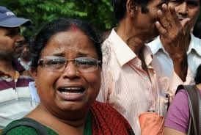
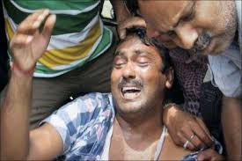
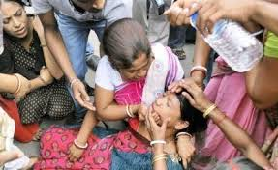
Who is accountable??
and a lot more...

Slide 18
Recent Legislative Developments
Companies Bill, 2012
Competition (Amendment) Bill, 2012
National Competition Policy
Central Monitoring Committee and Regional Task Forces on Vanishing Companies
Committee on Corporate Governance

Slide 19
Other Government Efforts
Investor Awareness Programmes
MCA-21 E-Governance project
Investor Education and Protection Fund
Redressal of Investors’ Grievances
Corporate Governance
Investigation of Corporate Frauds
Investor Grievance Management Cell

Slide 20
FSLRC Report
Financial Sector Legislative Reforms Commission
Consultations with regulators and stakeholders
Indian Financial Code
A Single regulatory authority for all financial services
Consolidation of SEBI, IRDA, FMC, etc.
Financial Redress Agency
Complaints of retails consumers against financial firms

Slide 21
FSLRC Report contd...
Resolution Corporation
Take up functions of DICGC
Resolve cases of falling financial firms
Financial Stability and Development Council
Analyse the financial system
Propose and implement solutions
Financial Sector Appellate Tribunal
Replace the SAT
Hear appeals against RBI, the UFA, decisions of the FRA

Slide 22
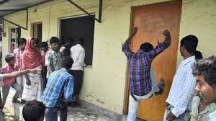
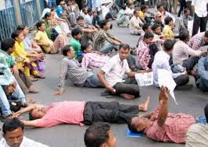
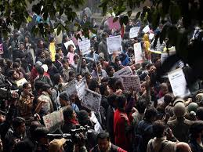
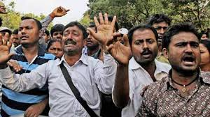
Wrong methods of protest!!!
Urgent: Raising public awareness

Slide 23
How to raise public awareness?
Parameters
Technique
Medium

Slide 24
Recommendations, their scope and Strategy for Implementation
1
Investor Dial Mechanism (IDM)
Why
To detect the unregistered companies
Who
Government
SEBI
How
Registering a new investor
To save investors from scams
To raise public awareness about capital market investments
To take complaints from investors
To keep track of the companies operating in the capital market
MCA
The company under which the investor is made
Answering to the queries of a potential investor
Briefing a potential investor about proper investment mechanism
Taking complaints of the investors to be further looked upon by SEBI and the Ministry

Slide 25
The Mechanism
Toll free no.
Register new investor
Answer queries of investors
Inform investors
Address grievances of investors
Regular audit by SEBI and MCA

Slide 26
Registering a new investor
If the caller is a new investor then he/she has to register with IDM by providing the
following details:
NAME
MAILING ADDRESS
PHONE NUMBER
E-MAIL ID
AADHAR CARD NUMBER (if any)
D.O.B
NAME OF THE COMPANY
ADDRESS OF THE COMPANY
INVESTMENT AMOUNT
MEDIUM OF INVESTMENT
CERTIFICATE ISSUED
Other details about the company (if any)
The government have to ensure that the investment is made against proper
certificates as per government norms. Every investment has to be made against a
certificate meeting certain guidelines as laid down by the government.

Slide 27
2
Promoting alternative sources of investment
Reviving rural banks
Mutual Funds and Insurance
Small savings scheme

Slide 28
Distribution of savers in various saving options

Slide 29
Distribution of Investment across various instruments
 | Bond | Debenture | IPO | Secondary Market | Mutual Fund | Derivative | Total
All India | 14.89 | 6.94 | 10.05 | 21.59 | 42.89 | 3.64 | 100
Urban | 15.07 | 8.57 | 8.47 | 21.25 | 40.80 | 5.85 | 100
Rural | 14.60 | 4.26 | 12.66 | 22.04 | 46.44 | 0.00 | 100
Distribution of Investors across Investment Portfolio (percent)

Slide 30
3
Investor guidelines
Law sets forth proper guidelines for investment
Investment against certificates as per government norms
Acquire company details before investing

Slide 31
4
Other Recommendations
Educating rural people on financial management and planning
Create “informed” investors
Fixed Commissions to agents
Fixed commission to agents as per RBI norms
Defined roles of agent
Clear-cut role defined for agents
Educate people on documents to cross-check before investing
Investors should acquire company details before deciding to invest
This will reduce recruiting random agents for collecting money
Similar to banking correspondents for payments and deposits at the fields working at the grass-root level

Slide 32
No forming network of agents
Agents should not be allowed to appoint sub-agents.
Company Branching
Initiative in rural areas
Organize events in rural areas in the form of films, shows, fun activities, nukkad natak, etc. to educate people on investments and the consequences thereof
This will help create a link between the investor and the company.
Permission from SEBI to open new branches
SEBI keeps track of the operations of these branches

Slide 33
Start at the Panchayat level
Gram Panchayats can organize ‘sabha’
Modernising rural banks
Banks in rural areas should be accessible to the illitearte and semi-literate
Teams from the municipal level can then educate people on scams
Complex banking system to be made simpler
Banks in rural areas should compete with urban banks

Slide 34
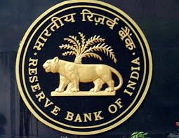
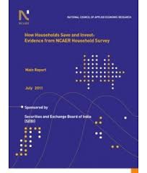
References
Notes:
Document all the references used for the research.

