Slide 1
Project Status Report
Name: Sharth Mandan
Institute: IIT Bombay
Mentor Name: Shri P V Rama Sastry
Institute: IG, NIA
Presentation Date: 15-06-2012
Notes:
Graphics, tables, and graphs
Keep it simple: If possible, use consistent, non-distracting styles and colors.
Label all graphs and tables.

Slide 2
Project ID # 63
Tackling Corruption from the Supply Side

Slide 3
Contents
Project Overview
What is the project about?
Goals and Objectives
Scope of the project
Your approach towards the project
Field visits and Mentor Discussion
Key Findings
Results and Discussions
Recommendations, their scope and Flow chart (Strategy) for Implementation
Suggestions for future work

Slide 4
Project Overview
What is the project about?
The project basically focuses on the supply side of corruption. The supply side of corruption includes, on a bigger scale, the private sector companies who indulge in bribing the public officials to get contracts, pass irregularities and procure resources. Overall, it is the corporate sector corruption, including the frauds and internal corruption within the private sector, which on large scale causes the supply side of corruption.
According to KPMG survey in 2011, 68% of the corruption in India is induced or initiated by the private sector, i.e. supply side.
The magnitude of corporate corruption, in last decade, has reached unimaginable heights. And so, it is utmost important to curb it.
Notes:
Project Overview
What is the project about?
Define the goal of this project
Define the scope of this project

Slide 5
Some figures:
Scandal | Corporates Involved | Order of money involved
2G Spectrum Scam- 2010 | Reliance Telecom (through Swann Telecom), Unitech Telecom, Tata Tele services | Rs. 176000 crore
CWG scam- 2010 | MTNL, HCL, Jaypee Group, AM Films, AM Cars, SIS Live | Rs. 70000 crore
Satyam Fraud Case- 2008 | Satyam IT | Rs. 14000 crore
Coal Mining Scam- 2012 | Several private and public firms including NTPC, Jindal Steel, Arcelor- Mittal, Aditya Birla, Essar and others | Rs. 1070000 crore
These four scams alone amount to Rs. 1330000 crore or 241 billion USD.
Also, Transparency International Bribe Payers’ Index 2011 ranked India 19th out of 28 surveyed countries, which is a very low rank and shows high probability of the Indian corporates to pay bribe in foreign countries.
So, it is a high time to devise and implement powerful anti-corruption measures in Indian Private Sector to curb supply side of corruption.

Slide 6
Goals and Objectives
To study the reasons for the existing corruption in the corporate sector in India and measures taken to tackle it.
To study the possibilities of replicating the anti-corruption measures of other countries in India.
To study the impact of some of the biggest scandals, in India and worldwide.
To study the different measures suggested by NGOs and civil society groups related to anti-corruption efforts and study their implications.
To come up with some practical workable anti-corruption measures in private sector which are profitable to the companies in long term as the companies are driven by commercial motives.
To finally suggest suitable measure to curb corruption from supply side.

Slide 7
Scope of the project
The supply side of corruption is a threat to India’s economical, social, political and material development. So, effectively tackling the issue would help in overall development of India in all the sectors. The scope of my project includes studying and tackling private sector corruption including fraud and bribery.
Briefly, following would be the scope of my project:
Critically examine the present situation in the country regarding the supply side, including laws, organizations, policies, case studies and other efforts.
Discuss with corporates, civil society groups and investigation agencies about the current problems to curb corruption and find suitable suggestions.
Suggest some viable and implementable alternatives or additions to the present anti-corruption system, which when implemented might decrease the level of corruption from supply side and overall develop the nation.

Slide 8
Your Approach Towards the Project
Pre- Mid Term
Got overview of project from Mentor and also directions in which the study should focus on.
First studied the present laws, organizations in India for anti-corruption, their efforts to reduce corruption from supply side and compared them with laws and agencies around the world.
Met several people in CBI, CVC, civil society groups and journalism and got their views on the problems and the proposed solutions.
Went through the proposed bills in parliament and drafts by various organizations and studied the effects of the implementations of these suggestions.
Studied various case studies on anti corruption in private sector and the case studies on scams to understand the different available options.
Notes:
In this slide, mention: after understanding the problem how you decided to approach it?

Slide 9
Your Approach Towards the Project
Post- Mid Term
Made a survey for compliance policies, but did not get enough responses from corporates.
Prepared a business case against corruption and Model Compliance Program for companies.
Studied in detail about procurement, corruption and transparency in procurement and forensic auditing.
Compiled all the results and made final report.
Notes:
In this slide, mention: after understanding the problem how you decided to approach it?

Slide 10
Field visits, Meetings and Interviews
Date | Name | Designation | Institution | Topic of Discussion
25/5/2012 | Shri Piyush Anand | Inspector General | Kanpur Zone | Anti-corruption laws and punishments.
26/5/2012 | Shri Rajesh Kumar | Deputy Superintendent of Police | Vigilance, Kanpur | Working of Vigilance.
5/6/2012 | Smt. Anupama Jha | Executive Director | Transparency International India | Working of TII, Integrity Pacts and other projects.
6/6/2012 | Shri Vipin Saxena | Special Resident Commissioner | Government of Orissa | Procurement and corruption in it
6/6/2012 | Mr Ravala Vijay | Project Associate | Global Compact Network India | Collective action project and procurement corruption
7/6/2012 | Shri P C Sharma | Superintendent of Police | Special Unit, CBI | Working of CBI in investigation of corruption cases
7/6/2012 | Mr Gopikrishnan | Special correspondent | The Pioneer | Role of media in curbing corruption

Slide 11
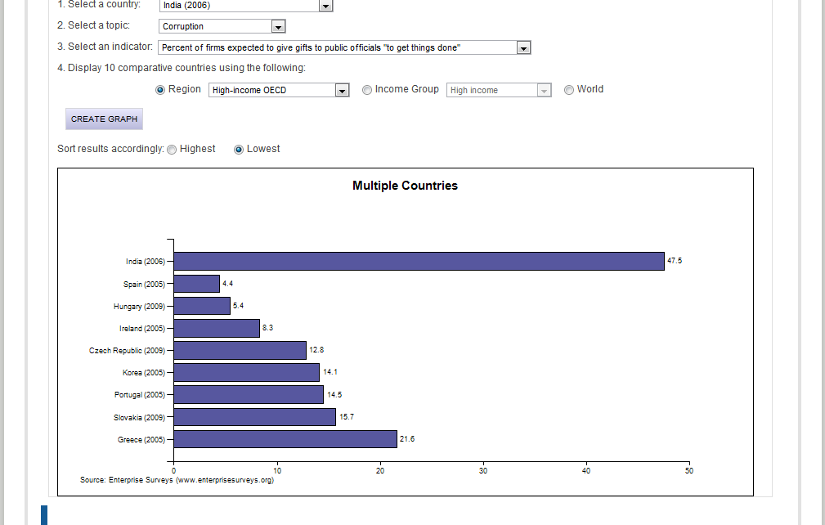
Key Findings: Study of Surveys
Enterprise Survey, 2006
Notes:
In this section report some facts and key findings made by you either by the analysis of the data collected by you or thorough field visits or literature survey

Slide 12
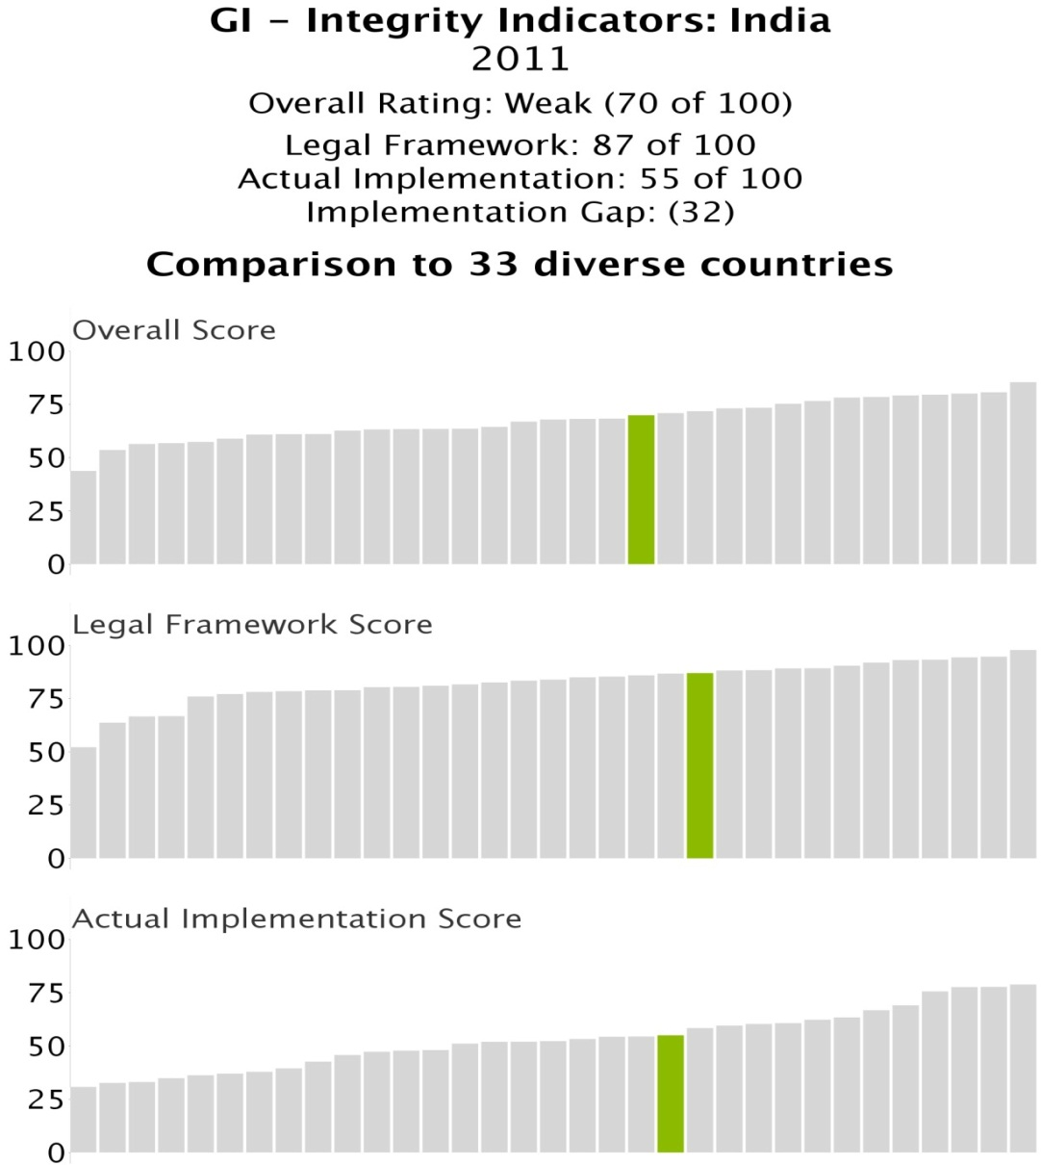
Key Findings: Study of Surveys
Global Integrity Report, 2011
Notes:
In this section report some facts and key findings made by you either by the analysis of the data collected by you or thorough field visits or literature survey

Slide 13
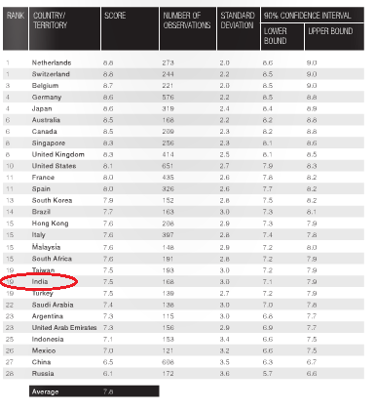
Key Findings: Study of Surveys
Bribe Payers’ Index, 2011
Notes:
In this section report some facts and key findings made by you either by the analysis of the data collected by you or thorough field visits or literature survey

Slide 14
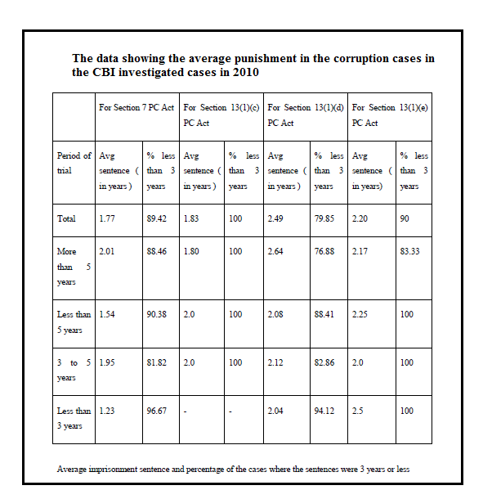
Key Findings: Study of Surveys
Notes:
In this section report some facts and key findings made by you either by the analysis of the data collected by you or thorough field visits or literature survey

Slide 15
Key Findings: Existing Anti-corruption Laws/ Agencies
Law/ Org. | Public Sector | Private Sector
PC Act [7] | Yes | No
CBI (Investigation powers) [15] | Yes | No
Indian Penal Code [8] | Yes | No
CVC (Investigation and recommendations powers) [16] | Yes (Advisory) | No
SFIO (not yet statutory body) [17] | Fraud cases in the listed companies under MCA | Fraud cases in the listed companies under MCA
Notes:
In this section report some facts and key findings made by you either by the analysis of the data collected by you or thorough field visits or literature survey

Slide 16
Key Findings: Major Anti-corruption Laws proposed
Whistle Blowers’ Protection Bill, 2011
Companies’ Bill, 2011 (and statutory status to SFIO)
The Prevention of Bribery of Foreign Public officials and Officials of Public International Organisations Bill, 2011
Public Procurement Bill, 2011
Notes:
In this section report some facts and key findings made by you either by the analysis of the data collected by you or thorough field visits or literature survey

Slide 17
Key Findings: Some anti-corruption practices in other countries and other International best practices.
Criminalization of foreign bribery under FCPA in US, UK Bribery Act in Britain, and in other countries like New Zealand, Columbia, etc.
Strict procurement laws in countries like Germany, Columbia, China, etc. regarding blacklisting of companies, transparency of tender allotment, etc.
Incentives for whistle blowers under FCPA.
UNGC Principles (10th principle against supply side corruption). 278 members in India of UNGC and 133 members of GCNI. Promoting Collective Action Project.
OECD convention against corruption. (35 member countries).
UN Convention Against Corruption.
Transparency International surveys on anti corruption and projects like Integrity Pact.
Notes:
In this section report some facts and key findings made by you either by the analysis of the data collected by you or thorough field visits or literature survey

Slide 18
Key Findings: Whistle Blowers
Presently, there are no whistle blowers’ or witness protection schemes in India.
Whistle Blowers’ protection Bill 2011 is in parliament.
No protection to witnesses in current system as accused gets details of witness in charge sheet.
Whistle blowers’ protection Bill 2011 covers only whistle blowers in public sector, not in private sector.
US, UK, Jamaica, Ghana, New Zealand, Ireland, South Africa all have laws for whistle blower protection, mostly in both private and public sector.
Under FCPA, the whistle blower have incentive of getting 20-30% of the fine amount! No such provision in India.
Apart from it, whistle blowers today get threats of losing job to threats of even life. In recent past, there have been cases of murders of whistle blowers. There are innumerable such cases of whistle blowers of corruption in NHAI, GE, Pfizer, etc.

Slide 19
Key Findings: Integrity Pact & Business Responsibility Report
IP proposed by TII. Focuses on transparency in procurement processes.
IP is implemented by private sector companies, by recommendations of CVC. IEMs employed for monitoring the procurement process.
Presently, IEMs act on complaints and suggestions of procuring entity. But they need to be given more and independent powers.
BRR is recommended by SEBI in private sector, after it rejected the proposal of being CVC-like body in private sector.
BRR includes 9 principles, out of which, first principle focuses on the ethical values of the companies.
The listed companies of SEBI have to submit a report on business responsibility every year, which will increase transparency of policies of companies and ethical practices of companies.

Slide 20
Key Findings: SFIO
SFIO deals with fraud cases in private sector also, but only by referring of government. It doesn’t have independent authority. It only investigates cases given by Ministry of Corporate Affairs.
Companies Bill 2011 proposes to give it statutory status, so it will be able to take up fraud cases on its own.
SFIO investigated cases are then sent to Company Law Board which carries out the prosecution part. No prosecution sanction required !
SFIO has investigated 83 fraud cases from 2003 to 2012 out of the registered 105 cases. Investigation is going on in remaining 22 cases. Thus, it is effective organization, with officials from various fields working in investigation.

Slide 21
Key Findings: UNGC and GCN signatories
The companies show their determination to fight against corruption along with other principles of UNGC.
10th principle of UNGC: Businesses should fight against corruption in all forms, including extortion and bribery.
278 companies signatories of UNGC
133 companies signatories of GCNI
Also, focus is given on procurement which is very vulnerable area for corruption.

Slide 22
Key findings: UNGC and GCN
3 levels to fight corruption
Internal
Compliance programs
Risk assessment
Collective
Reach to industry peers
External (Sharing with stakeholders)
Implement policies
Share policies
Share good practices
Suppliers, govt, stakeholders

Slide 23
Key Findings: Forensic Auditing
It is combination of Traditional accounting and auditing with financial detective work to prove legally if a fraud has been committed or not.
Reasons for falsifying accounts: 1) Absolute theft of value of money. 2)Stabilize and increase the value of stock and financial position of entities.
Advantages of Forensic Auditing:
Detection of Frauds.
Conduct Due Diligence.
Business Valuation.
Strengthens control mechanisms.
Ensure regulatory compliance.
Improve efficiency by identifying areas of waste.

Slide 24
Key Findings: E-procurement
E- Procurement
Indent Management
E- tender/ E-auction
Vendor Management
Catalogue Management
Contract Management

Slide 25
Key Findings: E-procurement: Advantages (Broadly)
Increasing Transparency.
Reduce Costs (upto 10% to 30%).
Better comparison of costs, tender specifications like expertise, etc.
Access to large database. (Literally worldwide)
Reduced paperwork.
Saving time and fast processing of tenders.
Compliance with laws.
Control on extravagant and unnecessary purchases.
Standardized procurement procedures and secure bidding environment.

Slide 26
Key Findings: Red Flags in Procurement
There are numerous ‘red flags’ mentioned by OECD and World Bank, that frequently are risk areas in procurement.
Some major red flags during procurement are:
Inconsistent cost estimates with respect to market rates
Unnecessary use of middleman for the procurement procedure, without any value addition
Altering the outcome of the selection process
tampering with bids
physical signs of collusion
Restricted advertising, information and notices.
Lack of transparency in the evaluation and selection procedure.
Dubious allocation of funds and fake bills, invoices, etc.

Slide 27
Results & Discussions: Business Case against corruption.
Business case covers:
1. Business Values
2. Costs of corruption
3. Difficulty in fighting the supply side corruption
4. Some recent scams
5. Importance of top level dedication and robust compliance program
6. Conclusion

Slide 28
Results and Discussions
Corruption from supply side needs to included in the ambit of PC Act and other laws.
A powerful and effective Act on lines of FCPA and UK Bribery Act needs to be implemented in India.
Stricter penalties, in terms of fine and prison term, to set example and make corruption deterrent. As previously seen, the fines and prison terms in India are very low in corruption cases, thus having no effect to produce fear in corrupt people.
Incentivizing whistle blowers and providing protection can help largely in detection of corruption in system. Lack of it is the main reason at present for demotivating the whistle blowers in present scenario.
Inclusion of private sector in Whistle Blower bill needed.
The bills in parliament, if passed, will be very important step towards anti-corruption. These bills should also include private sector in its ambit.
SFIO has proved to be a strong authority in investigation of cases in private sector. So it should be given more powers and its constitution be made at the earliest.
Notes:
In this section talk about the significance of key findings, discuss their importance for formulation of strategies and how they helped you in achieving your targets.
Discuss the role of the data collected by you and how the analysis of it helped you in getting the better picture of the problem at hand or helped in achieving your goals.

Slide 29
Results and Discussions Contd.
IP Project has increased transparency in procurement procedures. So, IP in private sector with strong and clear monitoring powers of IEMs.
The three principles of UNGC be implemented at all levels in all the companies to curb corruption.
Collective action, transparency through IP and IT, forensic auditing and technology and strong monitoring required in procurement process important to curb corruption.
A strong compliance program should be communicated in all the companies and recommended strongly to adopt it. The main focus points should be: The code of conduct, implementing the code, communicating the code among employees, whistle blowing mechanisms, complaint mediums, top management dedication.

Slide 30
Recommendations and their scope: POLICY RECOMMENDATIONS
Recommendation: Criminalizing Private Sector Corruption
It will Directly impact the private sector entities involved in corruption. Instill a fear in them to commit corruption.
2. Recommendation: Penalties on the Criminal offences under PC Act and IPC to Increase in penalties that are existing at present and also specifically include provision on recovery of assets.
Recommendation: Amendments in the Public Procurement Bill, 2011 including blacklisting of companies and transparency of tender allotment.
Recommendation: Amendment in Whistle Blowers’ Protection Bill to give protection to private sector whistle blowers and incentivize whistle blowing.
Recommendation: Amendments in SEBI directions clause_49 on corporate governance to include whistle blowing in mandatory recommendations by the clause.
Recommendation: Ombudsman Recommendations to increase powers of CVC, its independence, more stringent monitoring of CBI by CVC, powers to initiate investigations, transparency and impartiality in selection of CVC, newsletters on websites, identity secrecy and separate wing of CVC for private sector monitoring.
Notes:
In this section, mention the recommendations and if implemented what would be the scope of improvement and what strategy you have in mind for implementing these recommendations.

Slide 31
Flowchart (Strategy) for Implementation
Recommendation | Government Minister in charge of the concerned law
Criminalizing Private Sector Corruption | Minister of State in the Ministry of Personnel, Public Grievances and Pensions
Penalties on the Criminal offences under PC Act and IPC | Minister of State in the Ministry of Personnel, Public Grievances and Pensions
Amendment in Whistle Blowers’ Protection Bill | Minister of State in the Ministry of Personnel, Public Grievances and Pensions
Amendments in the Public Procurement Bill, 2011 | Vice-Chairman, Planning Commission of India or Ministry of Corporate affairs.
Amendments in SEBI directions clause_49 on corporate governance | Minister of Corporate Affairs, Ministry of Corporate Affairs.
Ombudsman Recommendations | Minister of Law & Justice
Form a draft for Amendment in bill or new bill
Gather support of NGOs and Civil Society Groups
Propose the draft to the government ministry or to any other minister supporting the amendment with all the support and ask the minister to take up the Bill in Parliament
Pressurize government for passing the law or amendments faster by targeting interests of the government
Notes:
Make a flow chart which would have the recommendations that needs to be implemented and the channel through which these recommendations would be analyzed for the feasibility and scope (different ranks in government, time process, budget) and then finally proceeded for the implementation.

Slide 32
Recommendations and their scope: OTHER RECOMMENDATIONS
Recommendation: Collective platform for whistle blowers.
Use of civil society groups and media to give information to whistle blowers, help them, protect them from threat by publicity and collective efforts. This medium can also act as a tool to maintain secrecy of whistle blowers.
Flow Chart for implementation:
gather support of NGOs and industry associations for wider reach
create a platform for the help of whistle blowers in the country, providing them information, mediums for help and other help
pressurise the government through this collective platform for whistle blower protection and incentives.
Notes:
In this section, mention the recommendations and if implemented what would be the scope of improvement and what strategy you have in mind for implementing these recommendations.

Slide 33
Recommendations and their scope: OTHER RECOMMENDATIONS
2. Recommendation: Peer review of Business Responsibility Reports.
By collective platform of civil society groups, industry associations and SEBI and government, peer review of BRR can be done. It will increase transparency, promote responsible practices and help the businesses to better their strategies.
Flow Chart for implementation:
gather support from industry associations, NGOs, SEBI and experts on corporate governance.
hold seminars in which compartive study of Business Responsibility Reports can be undertaken
promote good corporate practices through media and critic the shortcomings of companies.
Notes:
In this section, mention the recommendations and if implemented what would be the scope of improvement and what strategy you have in mind for implementing these recommendations.

Slide 34
Recommendations and their scope: OTHER RECOMMENDATIONS
3. Recommendation: Use of Technology in procurement and red flag indicators.
Technologies like e-procurement and e-payment can be promoted. Also, softwares available, which can catch corruption and fraud on the basis of the red flags and other pre-identified risk areas in procurement.
Prepare an extensive list of how technology can be used for the purpose of detecting corruption (Red flag indicators is one such list).
use the proper technology and configure it on the basis on the list prepared above.
get help from CVC, SEBI, Civil Society groups and industry associations and get the technology implemeted in the procurement procedures.
Notes:
In this section, mention the recommendations and if implemented what would be the scope of improvement and what strategy you have in mind for implementing these recommendations.

Slide 35
Recommendations : Model Compliance Program
MODEL COMPLIANCE PROGRAM:
Top level dedication.
Model code of ethics.
Role of Independent Directors.
Financial records and internal audit mechanism of the company.
Transparency in corruption related information.
Implementation and Communication of code of conduct among employees.
Ombudsman mechanism in company.
Compliant medium and whistle blowing mechanisms.
Recruitments and transparency in it.
Notes:
In this section, mention the recommendations and if implemented what would be the scope of improvement and what strategy you have in mind for implementing these recommendations.

Slide 36
Suggestions for future work
Focus on the role of media in tackling corruption from supply side and corporate corruption.
Possibility of formation of a separate agency, to act as an ombudsman for the private sector.
The menace of Private- Private sector corruption in procurement.
Critically examine various companies, and the efforts taken by them to increase transparency and accountability by going through the annual reports and websites of the companies.
Interact with the industry associations and clear their stand and view point on the matter of tackling corruption from supply side. Also, analyze their current efforts and look into what more can be done.
Examine the role of demand side of corruption in procurement and its role in inducing and increasing supply side of corruption. Come up with an action plan for tackling demand side of corruption.
Role of educational institutions and other mediums in installing values of ethics in young graduates.
Notes:
Given the limited time and enormity of the scope of the assigned projects, there are bound to be many aspects of the problems that could not be adequately or at all investigated. You should consult your mentor and should list all such aspects for further investigation

Slide 37
Questions????
Notes:
* If any of these issues caused a schedule delay or need to be discussed further, include details in next slide.

Slide 38
Appendix
Notes:
Prepare slides for the appendix in the event that more details or supplemental slides are needed.

